Slide 1
Fy21 (2021-2022) SHIP Grant Introduction
Illinois Critical Access Hospital Network

Slide 2
Small Rural Hospital Improvement Grant (SHIP)
Federally funded program
  ICAHN manages the grant on behalf of IDPH
All critical access hospitals are eligible
Small & rural hospitals under 49 beds are also eligible

Slide 3
FY21 SHIP Grant
Applications due by Friday January 22nd
Send to bashpole@icahn.org

Slide 4
FY21 SHIP Grant
Project period runs from June 1, 2021 – May 31, 2022
Three purchasing menu categories
  Value-Based Purchasing (VBP)
  Accountable Care Organization (ACO)
  Prospective Payment System/Payment Bundling (PPS/PB)
Funds can be used for individual hospital projects or for pooled network projects
Funding is anticipated to be approximately $11,000 per hospital

Slide 5
Grant Site visits
Requirement for receiving grants
Take place approximately every three years
Financial information & other grant documentation
  All receipts
  Any agendas, contracted services, agreements, etc.
  Signed grant agreement between your hospital and ICAHN
  Grant report

Slide 6
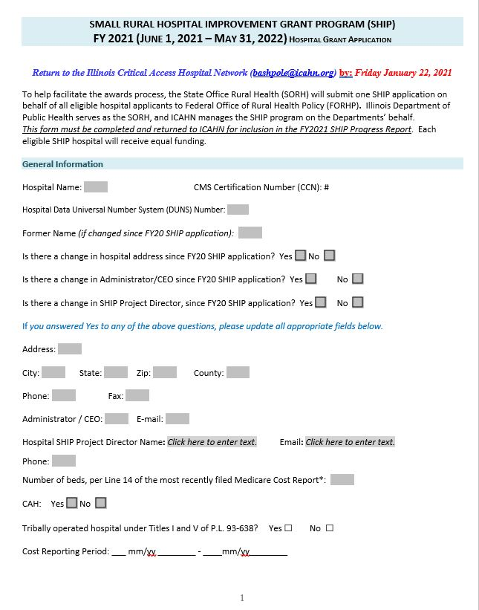
Application – Page 1
Similar to past years
Asking for DUNS # this year
If any changes to general information from previous application, please note those changes

Slide 7
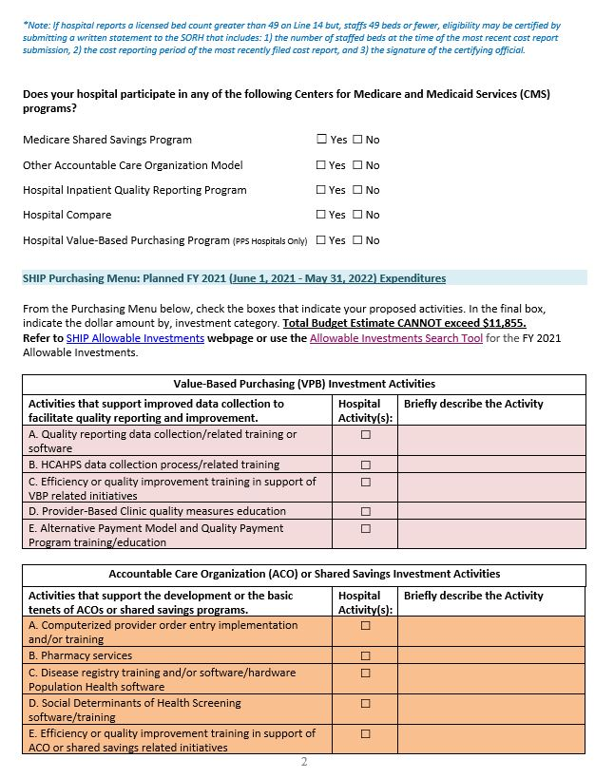
Application – page 2
Please check participation in CMS programs
Select and describe activity(ies) within purchase menu if you desire to do an individual project
If possible, please use detail when describing chosen activities

Slide 8
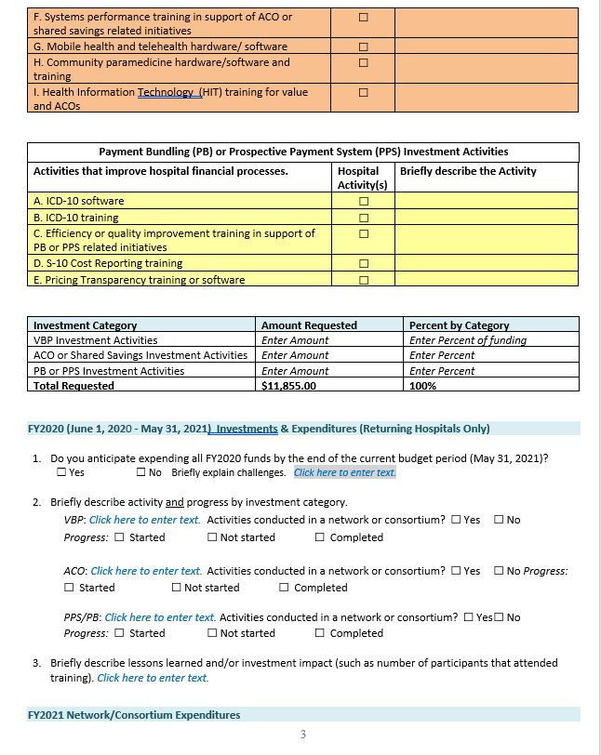
Application – Page 3
Continuation of purchasing menu
Enter what percentage/amount of funds requested by investment category
Describe current project period activity

Slide 9
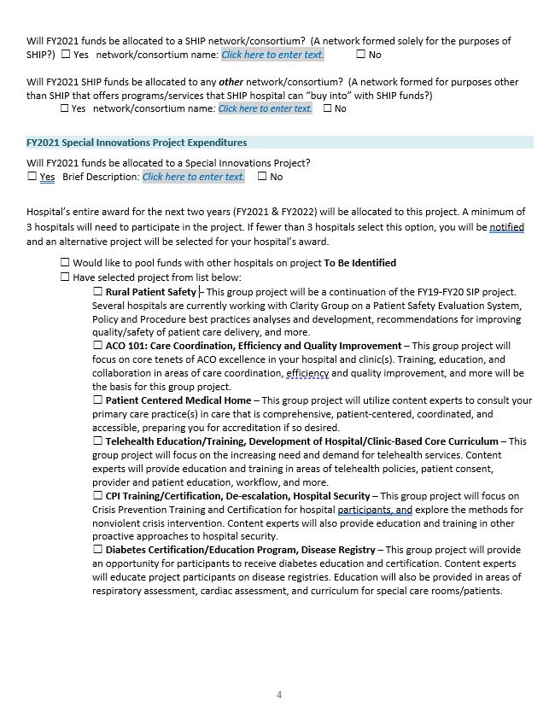
Application – page 4
Group project page
3 hospitals must select a project in order for it to move forward
Award for next two years will be allocated to chosen project

Slide 10
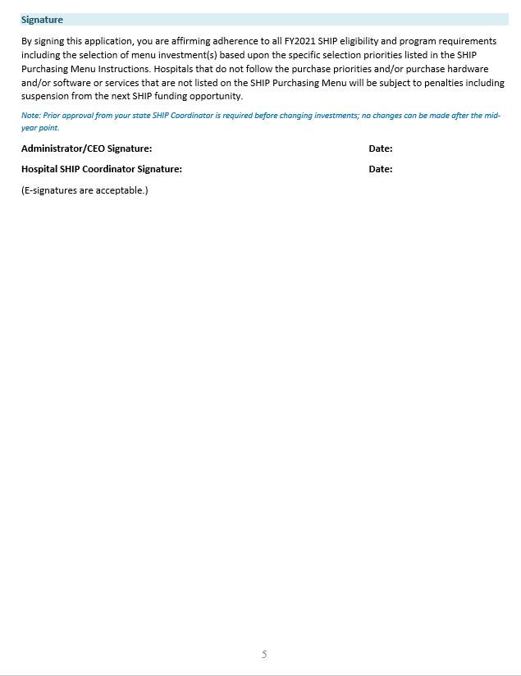
Application – page 5
Signature page
Please, if possible, have both CEO and project coordinator sign and date

Slide 11
Unallowable investments
Unallowable investments include but are not limited to:
  Travel costs
  Food
  Hospital staff salaries
  General equipment to support direct patient care
Please contact ICAHN (bashpole@icahn.org) if you have any questions at all about the appropriateness/allowability of an activity

Slide 12
FY21 SHIP Grant
Applications due by Friday January 22nd
Send to bashpole@icahn.org

Slide 13
Questions
Email bashpole@icahn.org
Call ICAHN office (815)875-2999

