Slide 1
Outpatient Nursing Services
Raigan Brown, MHA, RN
Chief Nursing Officer
Memorial Hospital
Carthage, IL

Slide 2
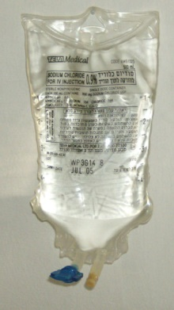
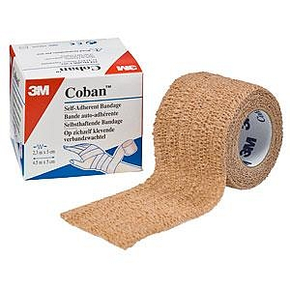
Overview
Currently, Memorial Hospital’s outpatient nursing services do not occur in one specific location or by designated staff.
Memorial Hospital’s wish is to designate a space and staff member(s) to conduct all outpatient nursing services.
Outpatient services recognized as a potential revenue source

Slide 3

Objectives
Collect data
Designate services that will occur (i.e. IV infusions, injections, wound care, lab draws)
Designate space
Ensure we are operating under the 340B program
Ensure an adequate pre-certification process
Ensure that patient billing is set up correctly
Designate staff

Slide 4

Planning Detour
In calendar year 2020, there were well over 2000 outpatient nursing services, for Hancock County residents, that were completed in outside organizations.
When discussions started, we were not going to include all chemotherapy services into our Outpatient Nursing Services department.
It was determined to look at getting all outpatient nursing services, including chemotherapy, included in this department.

Slide 5
Stakeholders
Current contracted provider group who provide outreach coverage for services
Memorial Hospital Administration and Governing Board
Potential contracted provider group who could provide additional outreach coverage for services
Employed providers for referrals and supervision of services

Slide 6
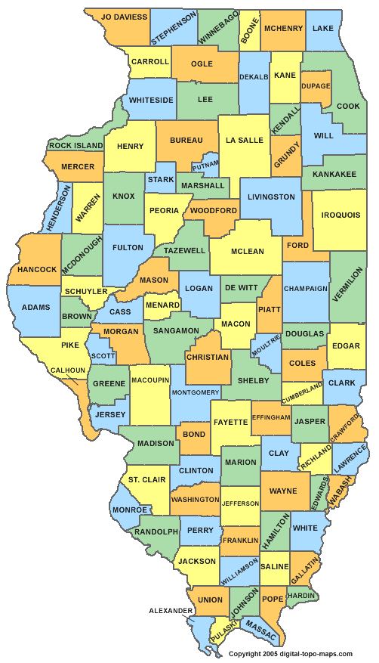
Activities
Site visits to potential contracted group locations
Visit to Memorial from potential contracted group

Slide 7

Obstacles
Collecting adequate data – no data analytics department
Changing deliverables of the department mid-data collection
Completing site visits due to busy schedules
Creating an ROI with accurate revenue and expense hypotheses

Slide 8

Next Steps
Visit to one more outside organization
Build an ROI based upon volumes at our last site visit, which will be similar in size, and estimated future volumes
Determine next steps with contract provider groups
Determine how many days per week for operation
Verify 340B drug pricing program usage
Approval for department setup
Epic edits for department setup
Hire staff to fulfil the needs & complete proper training
Provide marketing and education to providers, staff and the community about services available

Slide 9

Questions?

