Slide 1
Department KPI Project
An ICAHN Fellowship Project
By Harold Calderon
Marshall Browning Hospital

Slide 2
Statement
  Each department develop relevant KPIs based on activities, struggles, or issues currently experiencing

Slide 3
Purpose
  To provide a visual tracking tool that will help identify and develop actionable steps to help and improve each department and ultimately improve the hospital

Slide 4
Objectives
Develop
Develop visual tracking and presentation tool for staff and other stakeholders
Identify
Identify actionable items and provide focus
Improve
Improve communication

Slide 5
Stakeholders
  Department Staff
  Department managers/supervisors
  Executive leaders

Slide 6
Activities
  Discussion with managers/supervisors
  Each department identify and develop ideas for KPI
  Communicate using visual tools borrowed from Lean
  Follow up with each department
  Rounding by hospital leaders

Slide 7
Obstacles and barriers
  Resistance from staff due to bad experience from previous Lean initiatives
  Guidance: challenges in developing ideas by each department
  Limited resources on following up on departments

Slide 8
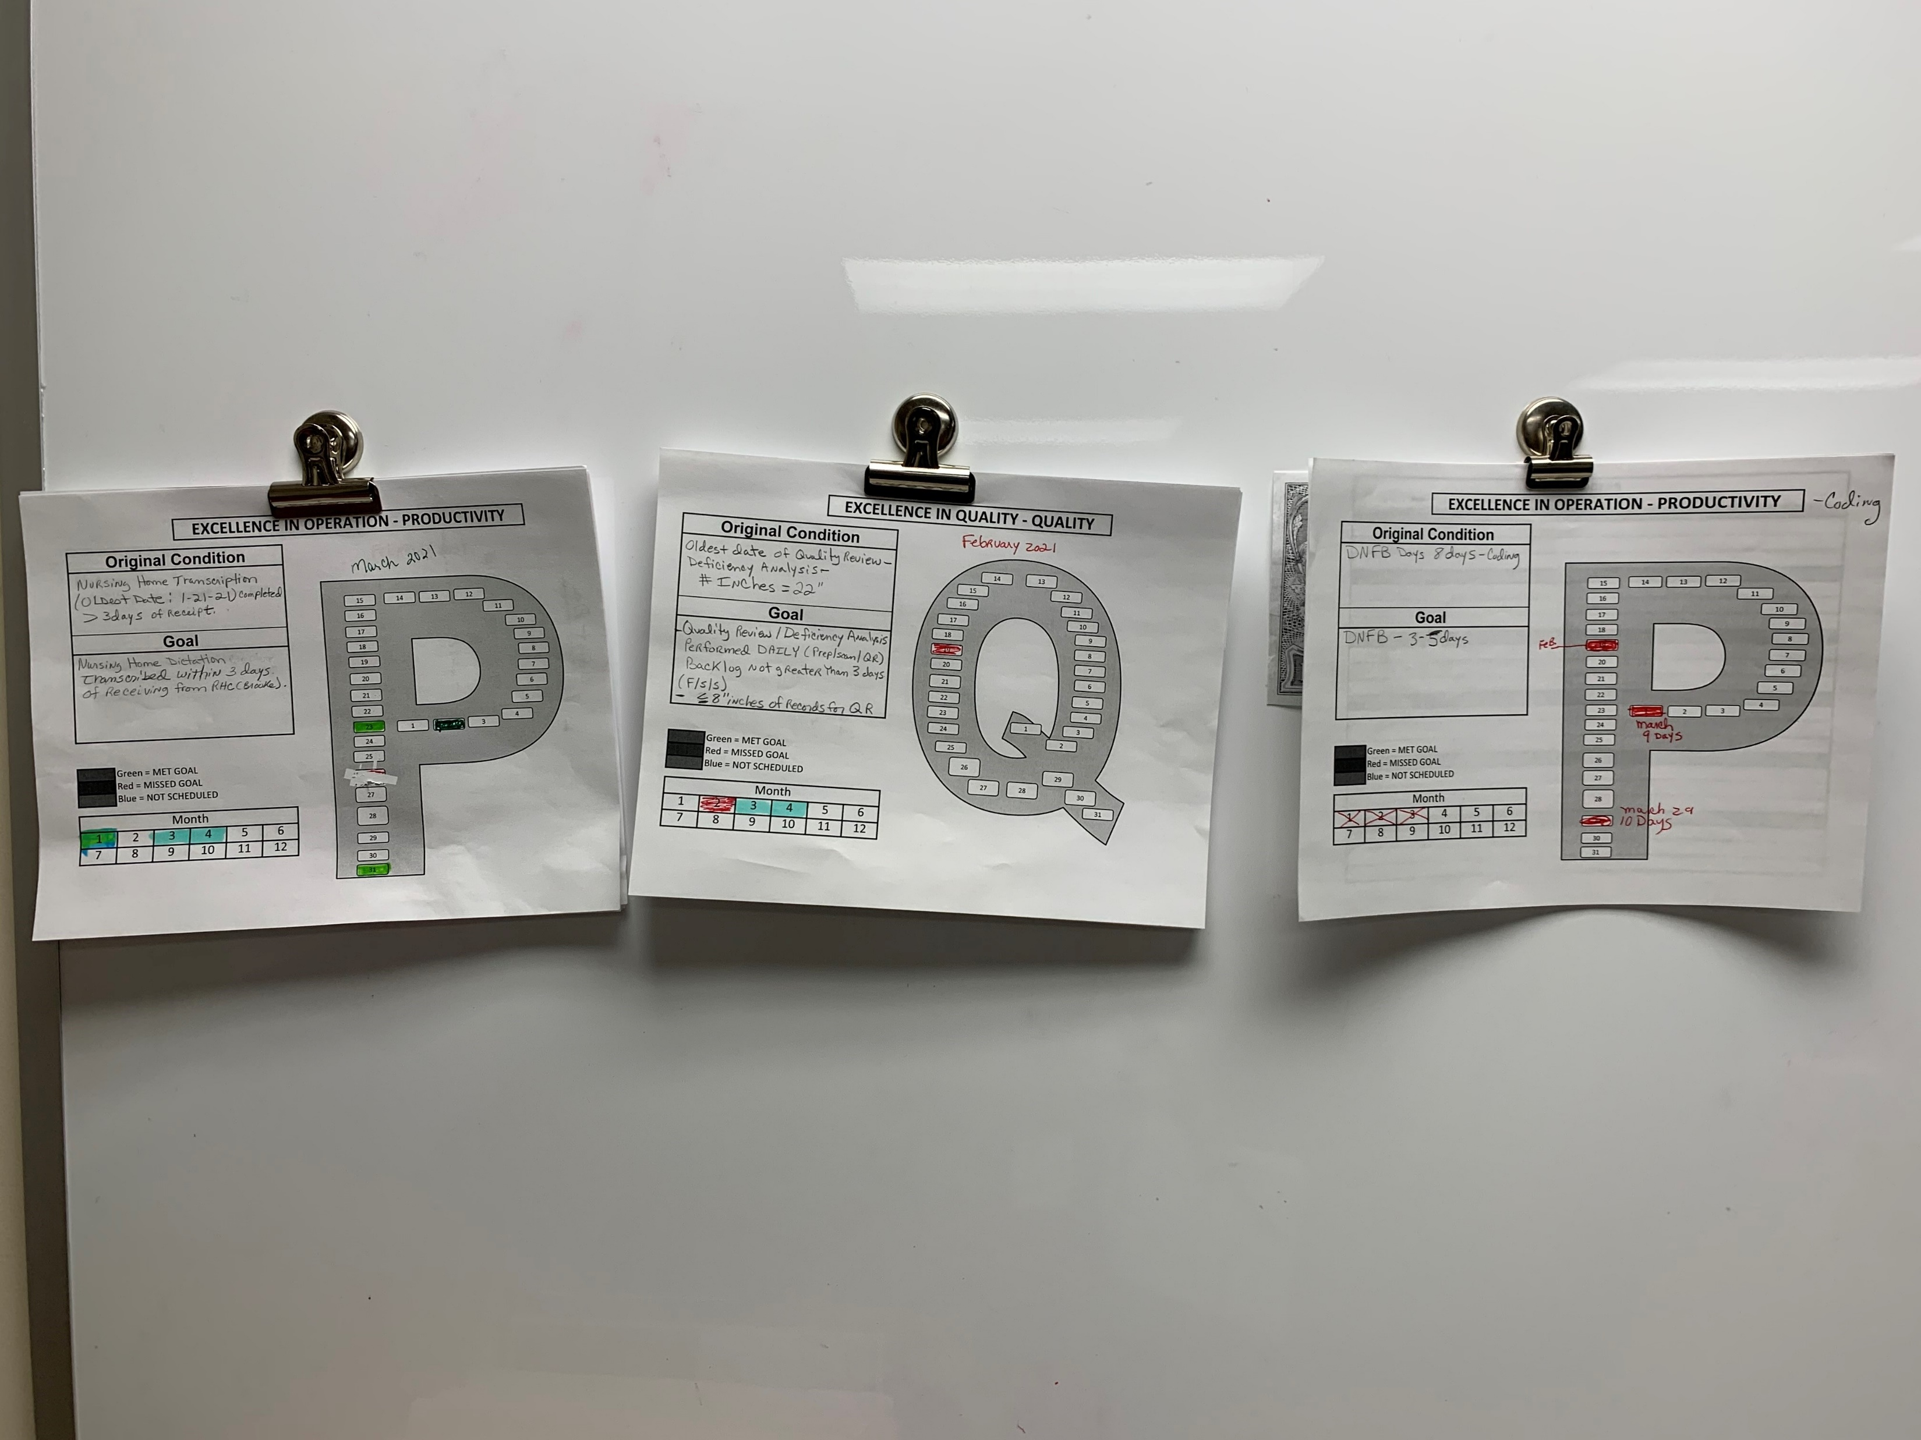
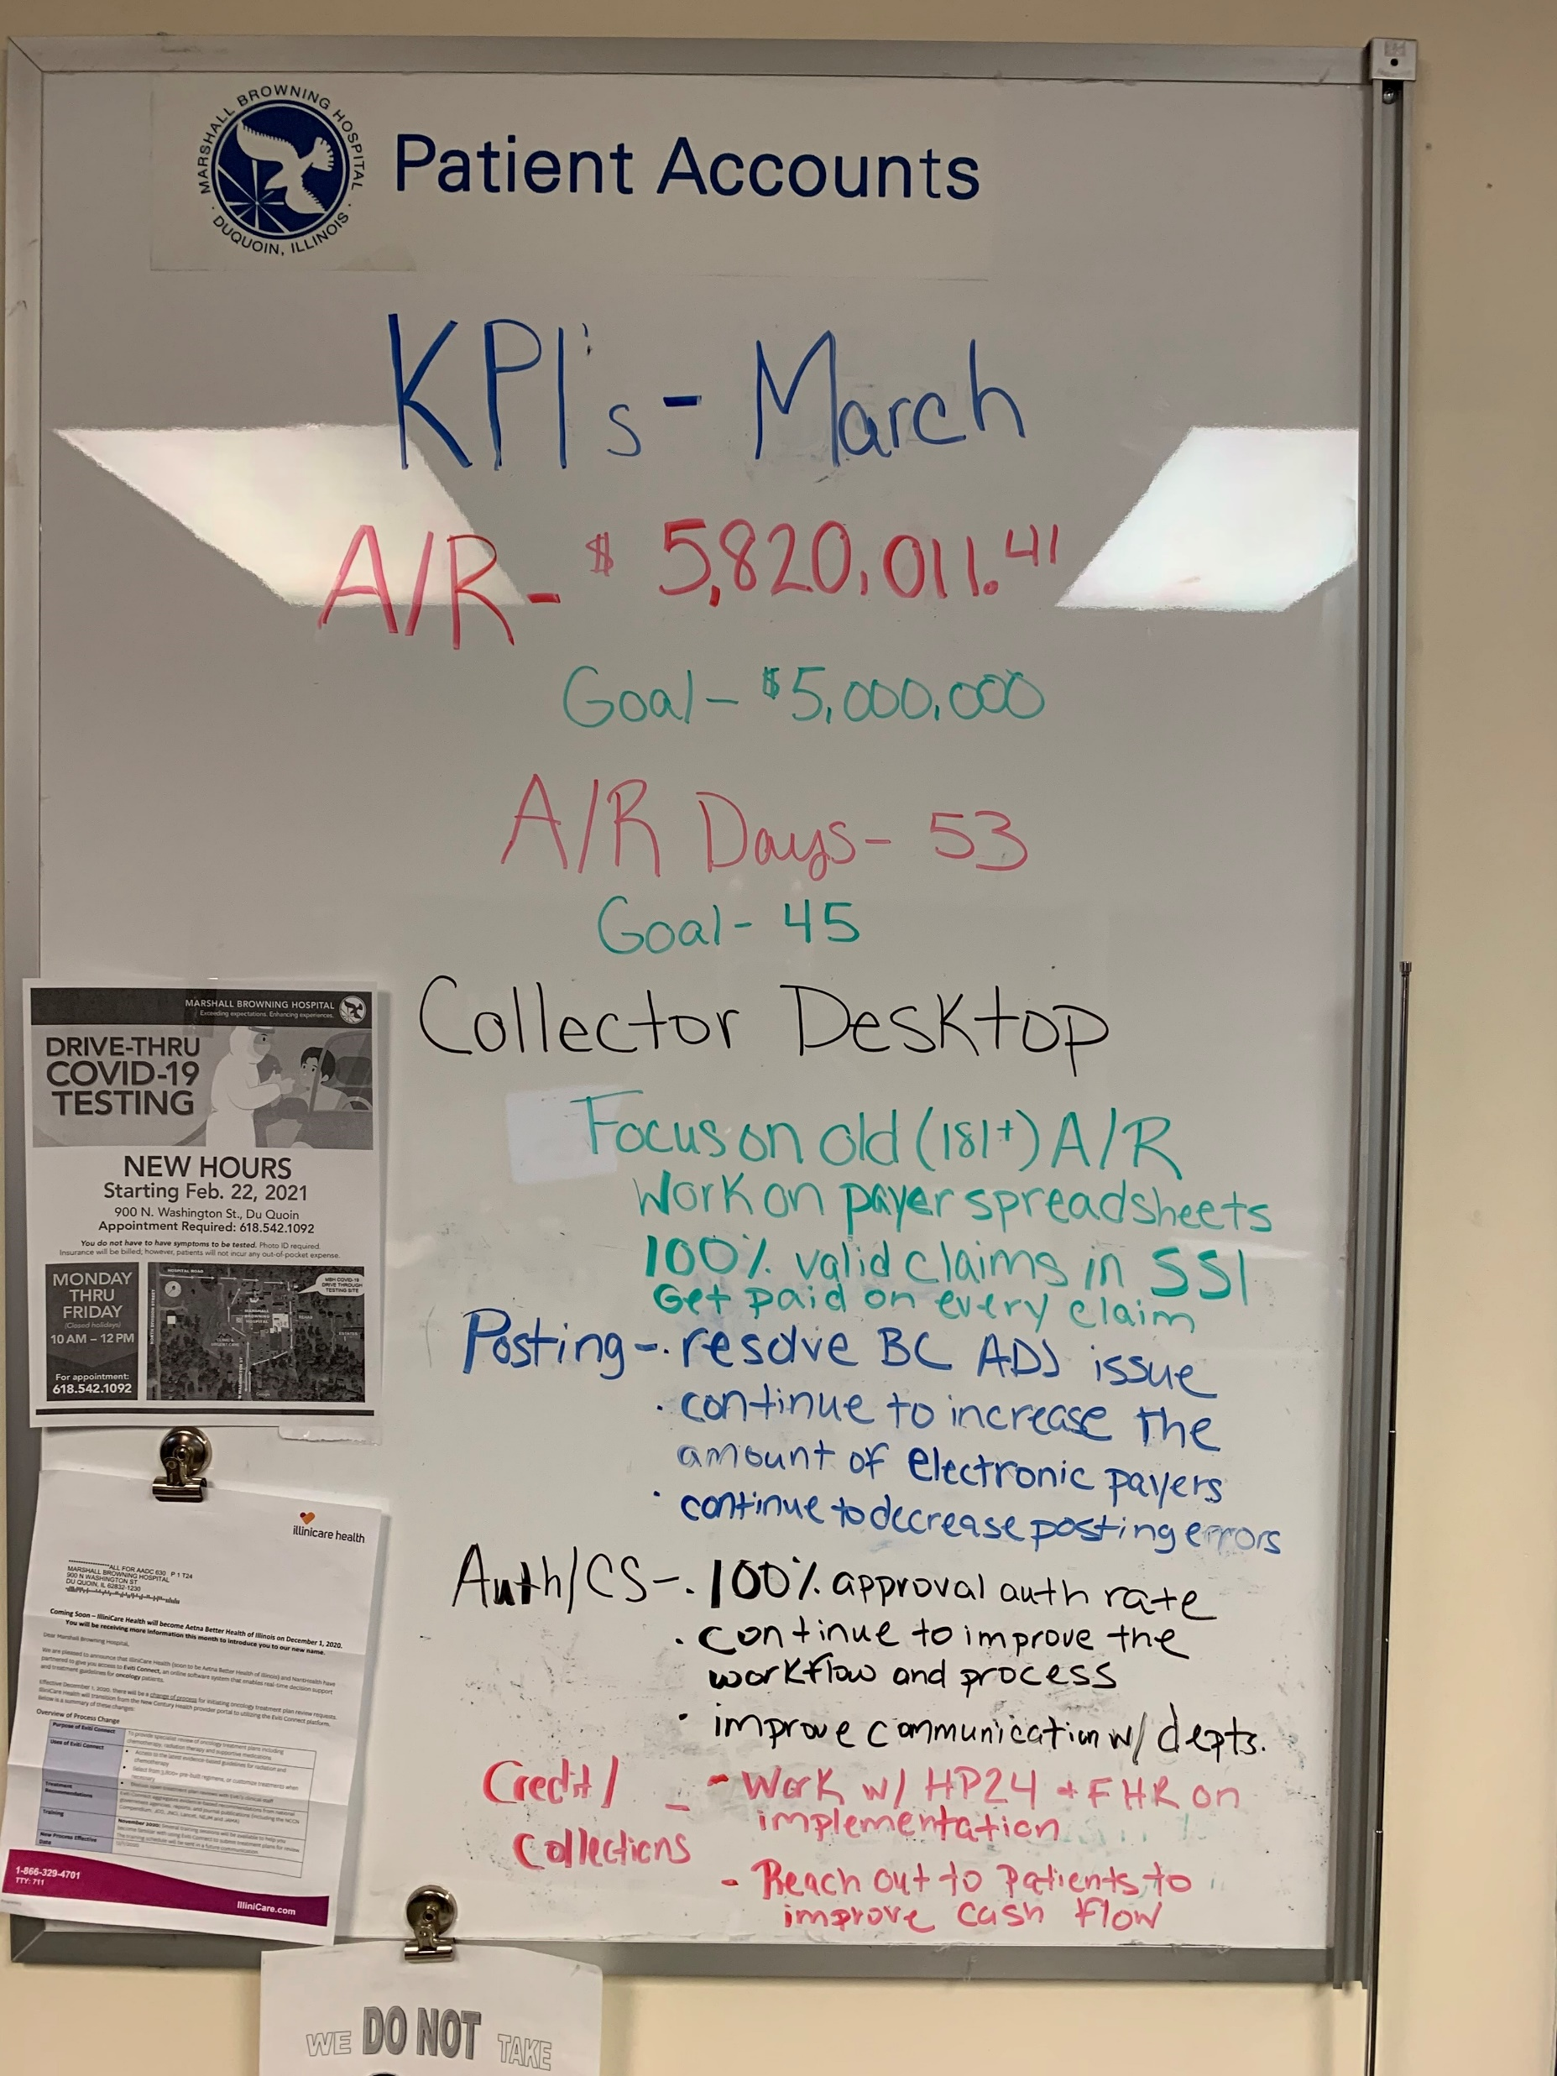
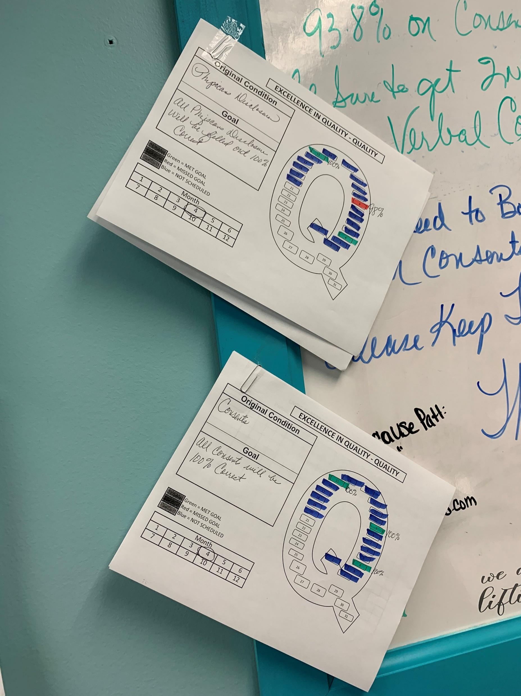
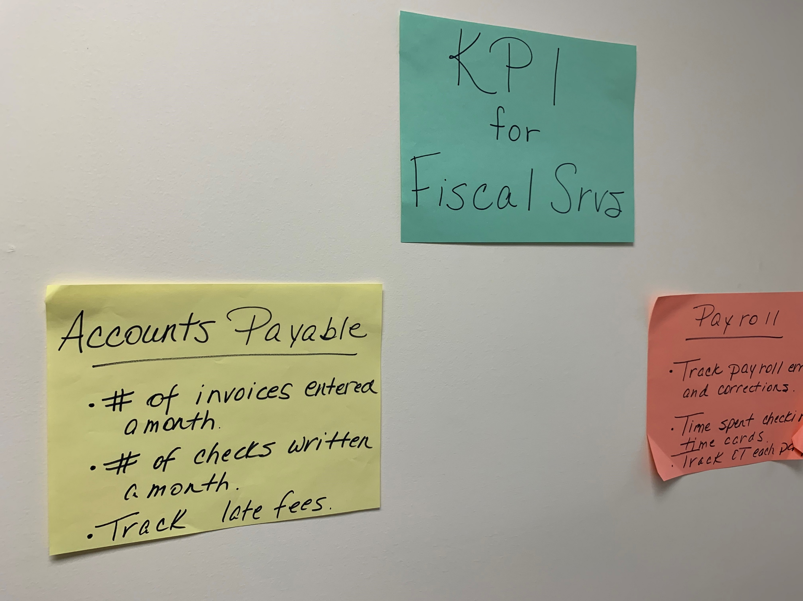
Outcomes
… and more to implement

Slide 9
Conclusions/ Next Steps
  Adapters – found it useful
  Continue implementing to the other departments
  Performance Improvement Officer

