Slide 1

ICAHN Rural Health fellowship
final project
Kim Calvert
Business intelligence for a critical
access hospital

Slide 2


Healthcare is one of the most utilized and essential sectors in business today
The United States alone accounts for 44.2% of the global healthcare providers’ sector value (MarketLine, 2020).
Most every single person will make practical and effective use of healthcare services as a fundamental part of their lives, to support their health and well-being

Slide 3


The focus on preventative healthcare continues to increase & the population seeking information on healthier lifestyles is also on the rise…however…
The need for medicinal, curative, and family practice will still be a necessity
As consumers, we have many choices when it comes to our healthcare and may only be limited by our insurance plan stipulations

Slide 4
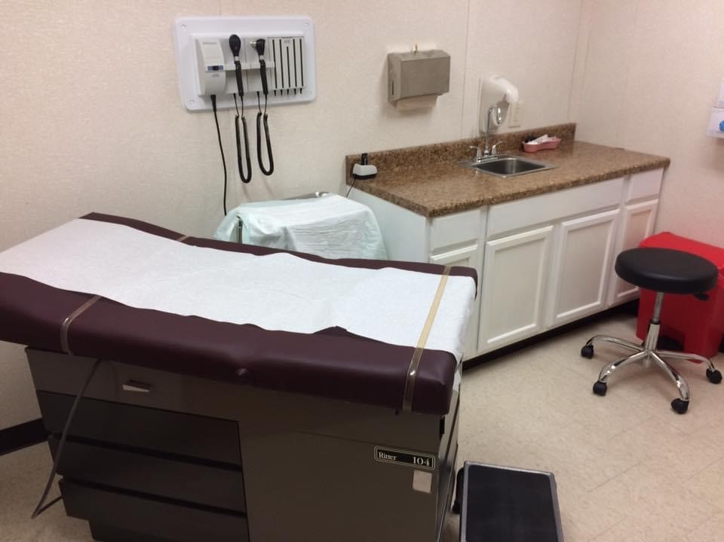

Healthcare organizations (HCOs) must compete for our business
In the U.S., the degree of rivalry among healthcare providers is very strong (MarketLine, 2020)
HCOs can gain an advantage by being competitive in service lines/offerings, price, quality of care, and efficiency
They can use Business Intelligence software to help with this!

Slide 5
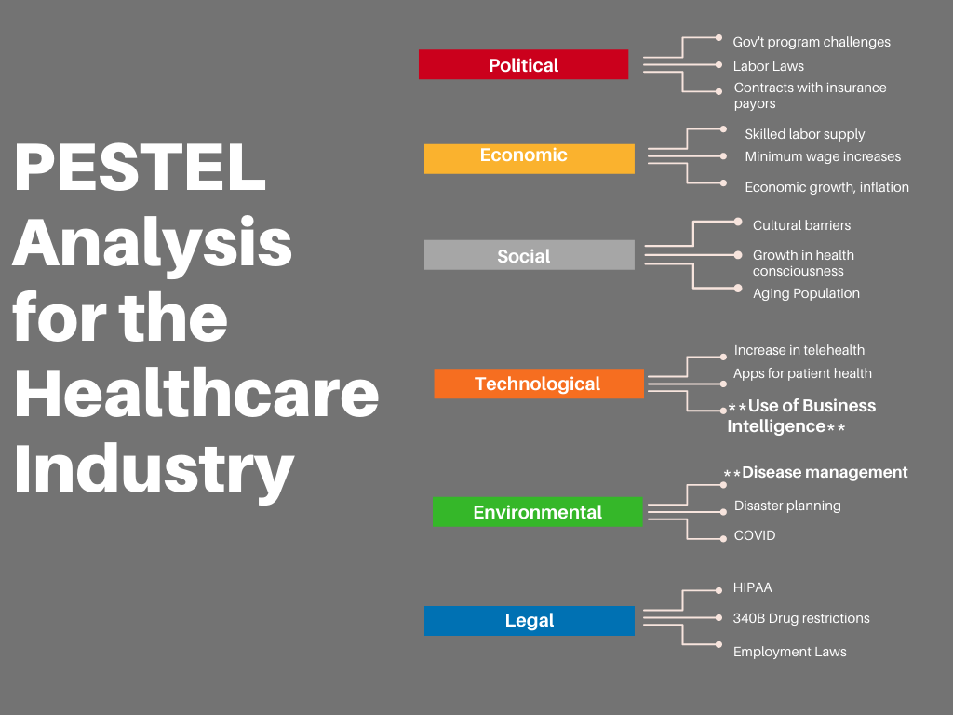
Notes:
Here is a PESTEL Analysis prepared specifically for the healthcare industry. I’ve highlighted the use of BI and Disease Management as I think they are very important. My case lies on the facts that BI can help HCO’s in many, many ways. One area includes Population Health management which could include disease management.

Slide 6


So much data!!
In the healthcare industry, leaders deal with massive amounts of data:
Hospital records & medical records
Results of lab tests, medical exams, other tests, etc.
Claims data
Payment information (EOBs, etc.)
Revenue and Expenses
Employee information
ETC!!
It becomes a challenge to manage all this data and extract what we need to run a successful hospital/healthcare organization
Notes:
HCOs have to deal with large amounts of data and it can be challenging to manage all of this data. BI can help with this.

Slide 7



3 main types of reports:
Built-in
Ad-hoc
Custom
When those don’t deliver, what do you do?
Notes:
This slide describes the 3 main types of reports available to most organizations. When you still cannot get the results you want, you have to get creative and think outside the box.

Slide 8

Business Intelligence can help!

Slide 9

What is BI?
Tool to facilitate decision-making by using a collection of decision support technologies from a variety of sources
The data is presented in a user-friendly fashion
Could include dashboards, graphs, charts, or other insightful visuals
The technology and applications that can assist organizations in gathering large amounts of data to make important and strategic decisions, including forecasting

Slide 10
What are the components of bi?
Data Source
From Excel files, EHR records, Databases…
Data Processing
After loading the data, the processing takes place
Data Analysis and Presentation
Finally, the data is analyzed and presented
This can be in the form of a dashboard, as one example, for a quick view of performance
(Denis-Catalin, Ioana-Gilia, & Miruna, 2019)

Slide 11
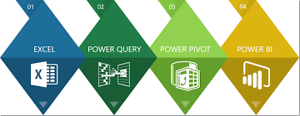
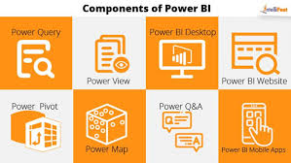
Microsoft Power BI
Power BI was developed from a set of Excel add-ons added in the Office 2013 Professional Suite release
Power Pivot – can handle millions of rows of data
Power Query – can manage over 60 sources
Power Map – mapping tool
Power View – dashboard tool that incorporates data and visuals from the other add-ins
(Snow, 2017)

Slide 12

How can this benefit horizon health?
We are a small, 25-bed critical access hospital in Paris, IL
We offer acute care, general care, inpatient and outpatient medical services, surgical services, emergency services, rehab, ambulance, etc.
Locations spread over 2 counties and 4 cities
Operations include: Paris Community Hospital, 3 Family Practice Clinics, 2 walk-in clinics, a visiting specialty clinic, and a health clinic exclusive to a major industry with a local presence
Significant growth over the last few years
Between 500-600 employees
18 employed physicians, 31 APRNs, and over 100 RNs

Slide 13
How can this benefit horizon health? (cont.)
We are led by an Administrative Team of a President/CEO, a VP of Finance/CFO, a CMO, and a CNO
We have a well-engaged Board
Reports are distributed monthly to the Finance Committee, the Board, and Leadership
***We can expand on the reports!! More visuals, more insights!!
***As we continue to grow, we need to be more analytical and be prepared to make great decisions

Slide 14
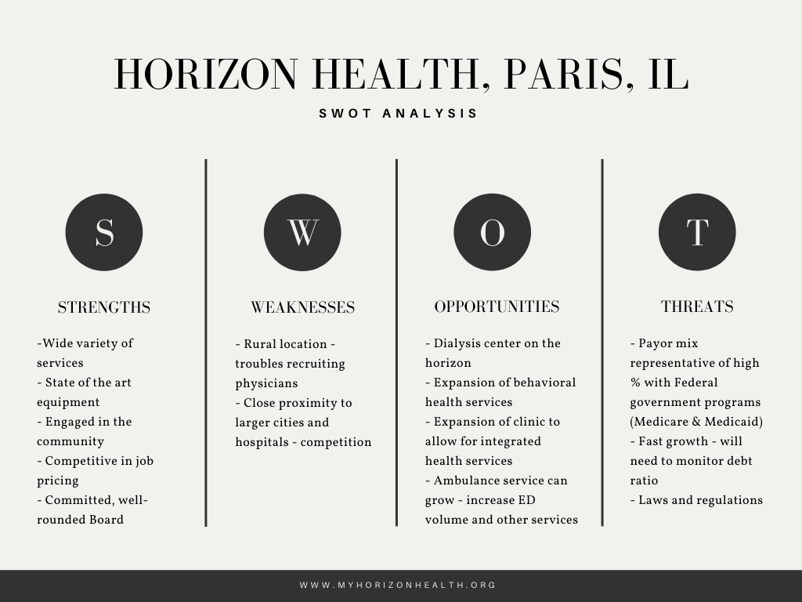
Notes:
SWOT analysis designed specifically for Horizon Health.

Slide 15

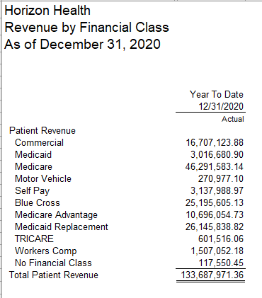
Something like this….

Slide 16
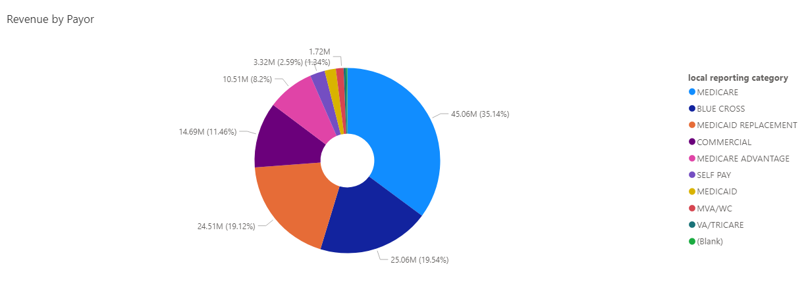
Total revenue by payor - 2020
Can instead be this!!!
Notes:
This is a great visual we could start using – however, this data is straight out of Athena. It doesn’t include Ambulance yet, or the little revenue still running through the Legacy system. Had to run the report an “abnormal” way in order to exclude patient data at this time.

Slide 17
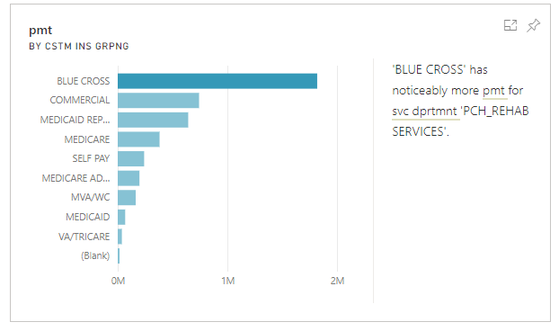

Quick Insights on data
The opportunities are endless!!
Notes:
The Quick Insights tool in Power BI is just that – it lends to quick and insightful data that you may have NOT even thought about or considered

Slide 18
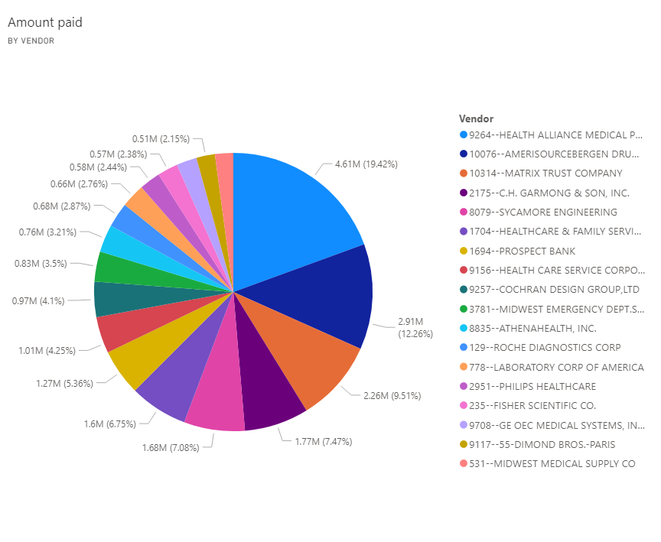
Vendor payments – 2020 – over $500k
Note: this pie chart was drafted in Power BI after uploading information for all of 2020’s vendor payments
Notes:
Currently, we don’t analyze amts paid by vendor on a regular basis – this could help
If we complete an open project we have that entails coding each vendor with a “type”, we could then quickly pull out valuable information such as – Top 10 contracted vendors – Top Legal vendors, etc.
This information is requested from auditors occasionally and for things such as the 990 or surveys

Slide 19


Business intelligence
BENEFITS
POSSIBLE DISADVANTAGES
Improved decision making!
Fast and accurate reporting
Valuable business insights!
Competitive analysis
Better data quality
Identifying market trends
(Here are 10 key benefits of business intelligence software, 2020)
Data breaches
High prices
Difficulty analyzing different data sources
Poor data quality
Resistance to adoption
(Danziger, 2020)
Notes:
There are possible disadvantages but the benefits outweigh those, in comparison

Slide 20
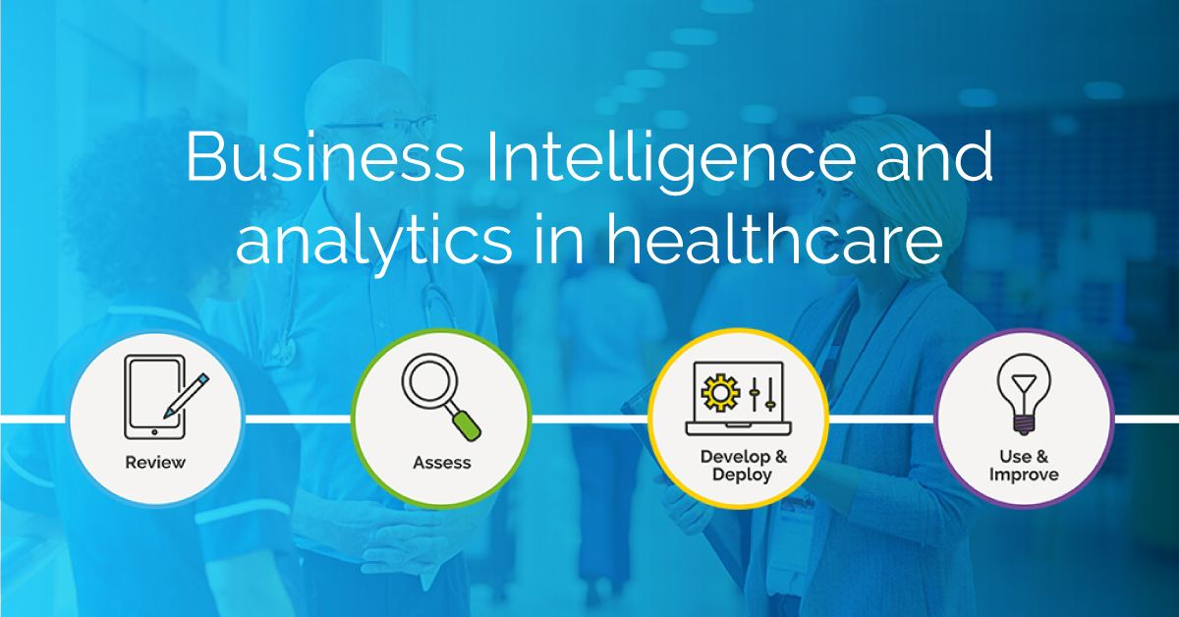
Goals/what’s next for horizon health
EXPAND MONTHLY REPORTING
Deeper dives into data - Revenue Trends, Payment Trends, etc.
Look into enhanced reporting for monthly statistics – visual, graphs, trends
Accounts Payable data – finish Vendor Type Project in Finance – A/P for deeper insights (will help with Audit/990 information)
KPIs – get comparable information from HFMA or ICAHN (so specific to critical access)
Notes:
We can greatly expand our monthly reporting and start looking at trends more. We can get our monthly statistics into a format for upload into MS Power BI for actual visuals and graphs! We can look at Key Performance Indicators and seek goals for a critical access hospital from Hospital Financial Managers Assoc or Illinois Critical Access Hospital Network

Slide 21
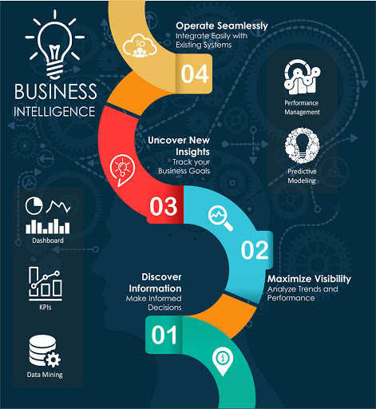
Goals/what’s next for horizon health (cont.)
OTHER POSSIBILITIES
We can use Power BI to help manage Population Health! Disease management!
What about Revenue Cycle – claims management, denials, Days in A/R, etc. – we are currently paying a consultant for an Accounts Receivable Dashboard – can we do this ourselves now?...
Analyzing staffing productivity – look at hours in all clinical areas vs. revenue, expenses, and net
Notes:
Population Health and Disease Management can be a HUGE thing for us to explore. This can help us to live and breathe by our Vision and Mission and to manage initiatives from our Community Health Needs Assessment. If used for Revenue Cycle process, we can possibly build a great dashboard and eliminate consultant fees of $1,000 per mo

Slide 22

Goals/what’s next for horizon health (cont.)
CONCERNS/ PRECAUTIONS
Information coming from multiple sources (Athena/EHR, Intacct, data in Excel, other 3rd party software)
Some files will need “scrubbed” first
Can’t do everything at once
IS still working on Microsoft upgrades
Notes:
Waiting on IS to purchase/install the software

Slide 23
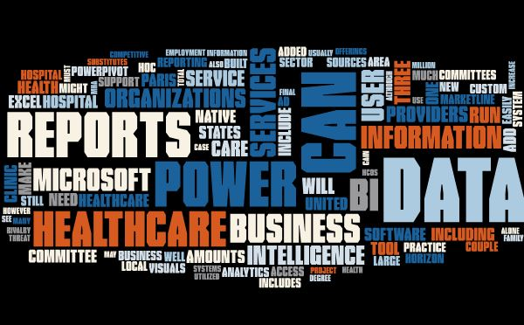
SUMMARY
HCOs can benefit greatly
Better decision making
Improved profitability
Improved quality of service
Patient safety and satisfaction
Improvements in population health
Much, much more!
Notes:
Word Cloud from my paper

Slide 24



THANK YOU
Kim Calvert
+1 (217)251-7490
kcalvert@myhorizonhealth.org

Slide 25
Becker, L. T., & Gould, E. M. (2019). Microsoft Power BI: Extending Excel to Manipulate, Analyze, and Visualize Diverse Data. Serials Review, 45(3), 184-188. doi:https://doi-org.ezproxy.smwc.edu/10.1080/00987913.2019.1644891
Booth, D. (2019). Building Capacity to Leverage Reports. Journal of Environmental Health, 81(8), 30-31.
Bresnick, J. (2019, December 18). Leveraging business intelligence for healthcare management. Retrieved March 27, 2021, from https://healthitanalytics.com/features/leveraging-business-intelligence-for-healthcare-management
Brown, B. (2016, August). Using business intelligence to bring financial challenges into focus. Hfm (Healthcare Financial Management), 70(8), 54-63.
Coroban, L., & Gavrila, A. A. (2019). Exploring the Relations between Business Intelligence and the Learning Organization. Review of International Comparative Management, 20(2), 198-204. doi:https://doi-org.ezproxy.smwc.edu/10.24818/RMCI.2019.2.198
Danziger, C. (2020, February 14). 5 disadvantages of business intelligence and how to avoid them. Retrieved March 13, 2021, from https://www.business2community.com/business-intelligence/5-disadvantages-of-business-intelligence-and-how-to-avoid-them-02284003

Slide 26
Denis-Catalin, A., Ioana-Gilia, D., & Miruna, O. (2019). Organizational development through Business Intelligence and Data Mining. Database Systems Journal, X(1), 82-99. doi:https://doaj-org.ezproxy.smwc.edu/article/6080c28439bb4784ac546288dc85cb25
Here are 10 key benefits of business intelligence software. (2020, June). Retrieved March 13, 2021, from https://www.mastersindatascience.org/learning/benefits-of-business-intelligence/
Horizon Health. (n.d.). Community Health Needs Assessment. Retrieved March 31, 2021, from https://www.myhorizonhealth.org/community-resources/community-health-needs-assessment/
Isazad Mashinchi, M., Ojo, A., & Sullivan, F. J. (2019). Analysis of Business Intelligence Applications in Healthcare Organizations. Hawaii International Conference on System Sciences 2019, HICSS(52).
Knight, D., Knight, B., Pearson, M., & Quintana, M. (2018). Microsoft Power BI Quick Start Guide: Build Dashboards and Visualizations to Make Your Data Come to Life. Birmingham, UK: Packt Publishing.
MarketLine. (2020, April 24). Healthcare Providers in the United States. Retrieved March 5, 2020, from https://advantage-marketline-com.ezproxy.smwc.edu/Analysis/ViewasPDF/united-states-healthcare-providers-98202.

Slide 27
Snow, M. (2017). The Power of Business Intelligence (BI) within Office 2013. Armed Forces Comptroller, 62(1), 40-47.
Thomas, S. W., CPA. (2020, March 01). Power bi: An analytical view. Retrieved March 21, 2021, from https://www.journalofaccountancy.com/issues/2020/mar/microsoft-power-bi-data-excel.html
Tikkanen, R., & Abrams, M. K. (n.d.). U.S. Health Care from a Global Perspective, 2019: Higher Spending, Worse Outcomes? Commonwealth Fund, (Jan. 2020). doi:https://doi.org/10.26099/7avy-fc29
U.S. Bureau of Labor Statistics. (2021, April 02). Healthcare support occupations had employment of 6.4 million in May 2020. Retrieved April 02, 2021, from https://www.bls.gov/opub/ted/2021/healthcare-support-occupations-had-employment-of-6-4-million-in-may-2020.htm

