Slide 1
ICAHN Fellowship Project
Arica Schmidt, BS, MLS(ASCP)cm
Midwest Medical Center Laboratory Director

Slide 2
Continuous Quality Improvement
(CQI)
Lean with a twist of Just Culture

Slide 3
Revamp Midwest Medical Center CQI program
-Long term strategic plan
Our Chief Executive Officer encouraged the project.
There is no “one size fits all” CQI program.
A limitation of the no “One Size Fits All” program is the time it takes to give a through review to ensure a good fit for our culture and make it an achievable and sustainable program.
This review spans multiple interdisciplinary team members (dept specific to Assistant Director Of Nursing), therefore, many schedules to juggle and ideas to concur on.
REAP the rewards!!

Slide 4
TNIH
High Sensitivity Troponin
Cutover method replacement

Slide 5
12 month delay of TNIH from COVID
What were my biggest obstacles?
Cerner is always my BIGGEST obstacle.
March 31, 2021
Quality control levels were expiring; therefore, date was preselected.

Slide 6
High Sensitivity Troponin-Top Lab Priority
Reduce cost because of quicker detection
Reduce Emergency Room time
Very sensitive to myocardium necrosis
Step 1 Why switch methods
Clinic providers
ER doctors
Lab staff
Step 2 Who needs training on new method
Pathologist guidance for support of new method
National transition of method across the board
Create memo with Pathologist for benefits of switch, ref ranges, etc..
When controls expire on current method, time to switch
A year ago before COVID it was set-up and correlated on analyzer, need refresher
One day cutover to new method (current method no longer available)
Step 3 When/How to switch methods
Memo sent out two weeks before cutover
Four month notice at each Medical Staff meetings they were told of the switch
Step 4 DO IT
Cerner interface creation
Go live with interface and switching of method
Anticipate the first patient
Anticipate provider questions
Myself
Shorten cardiac marker sets from baseline, two hour, three hour, or four hour repeats to baseline one hour and/or two hour repeats

Slide 7
TNIH
Outcome=Successful
Conclusion
VERY well received.
Passed the test with our most critical ER doctor (success measured by only doing one set of cardiac markers for screening instead of three).
Clinical presentation matching results.
Matching the goal of quicker ER turn-around-times.
Reduced cost for patient and staffing freed up.
Lab staff time reduced for testing time and waiting for drawn out cardiac marker repeats.

Slide 8
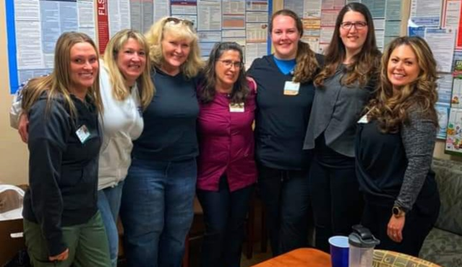
Science and Quality are the culture of our lab

