Slide 1
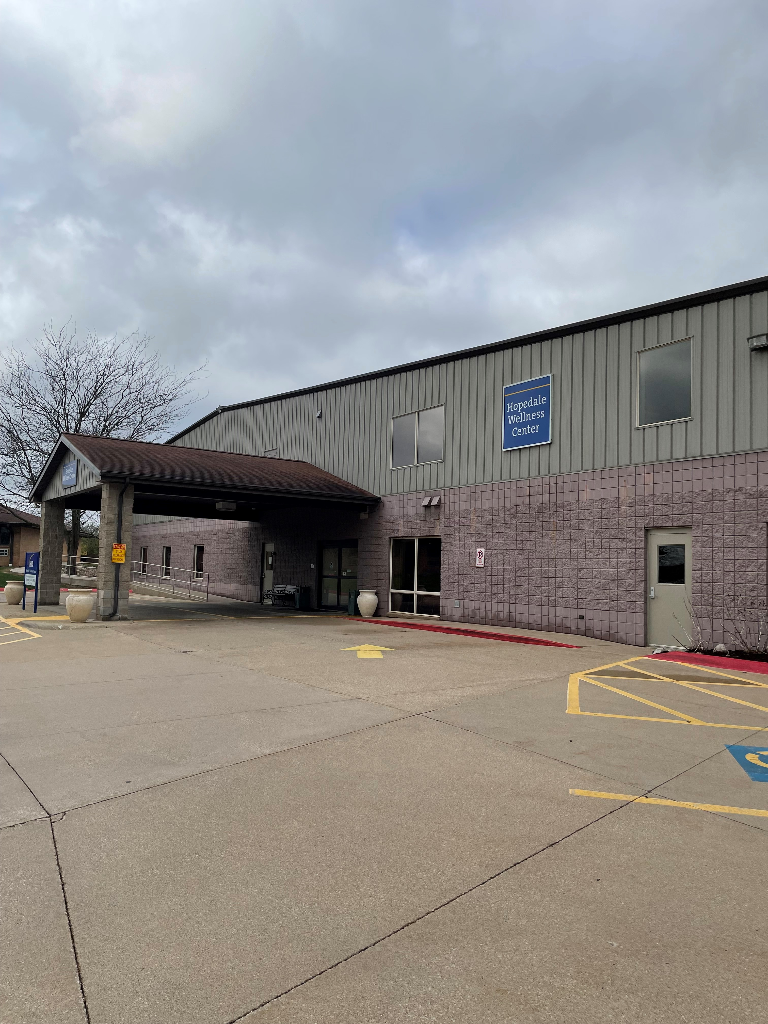


Wellness Center
Community Collaboration
A committee to develop healthier communities
Located on the campus of the Hopedale Medical Complex

Slide 2
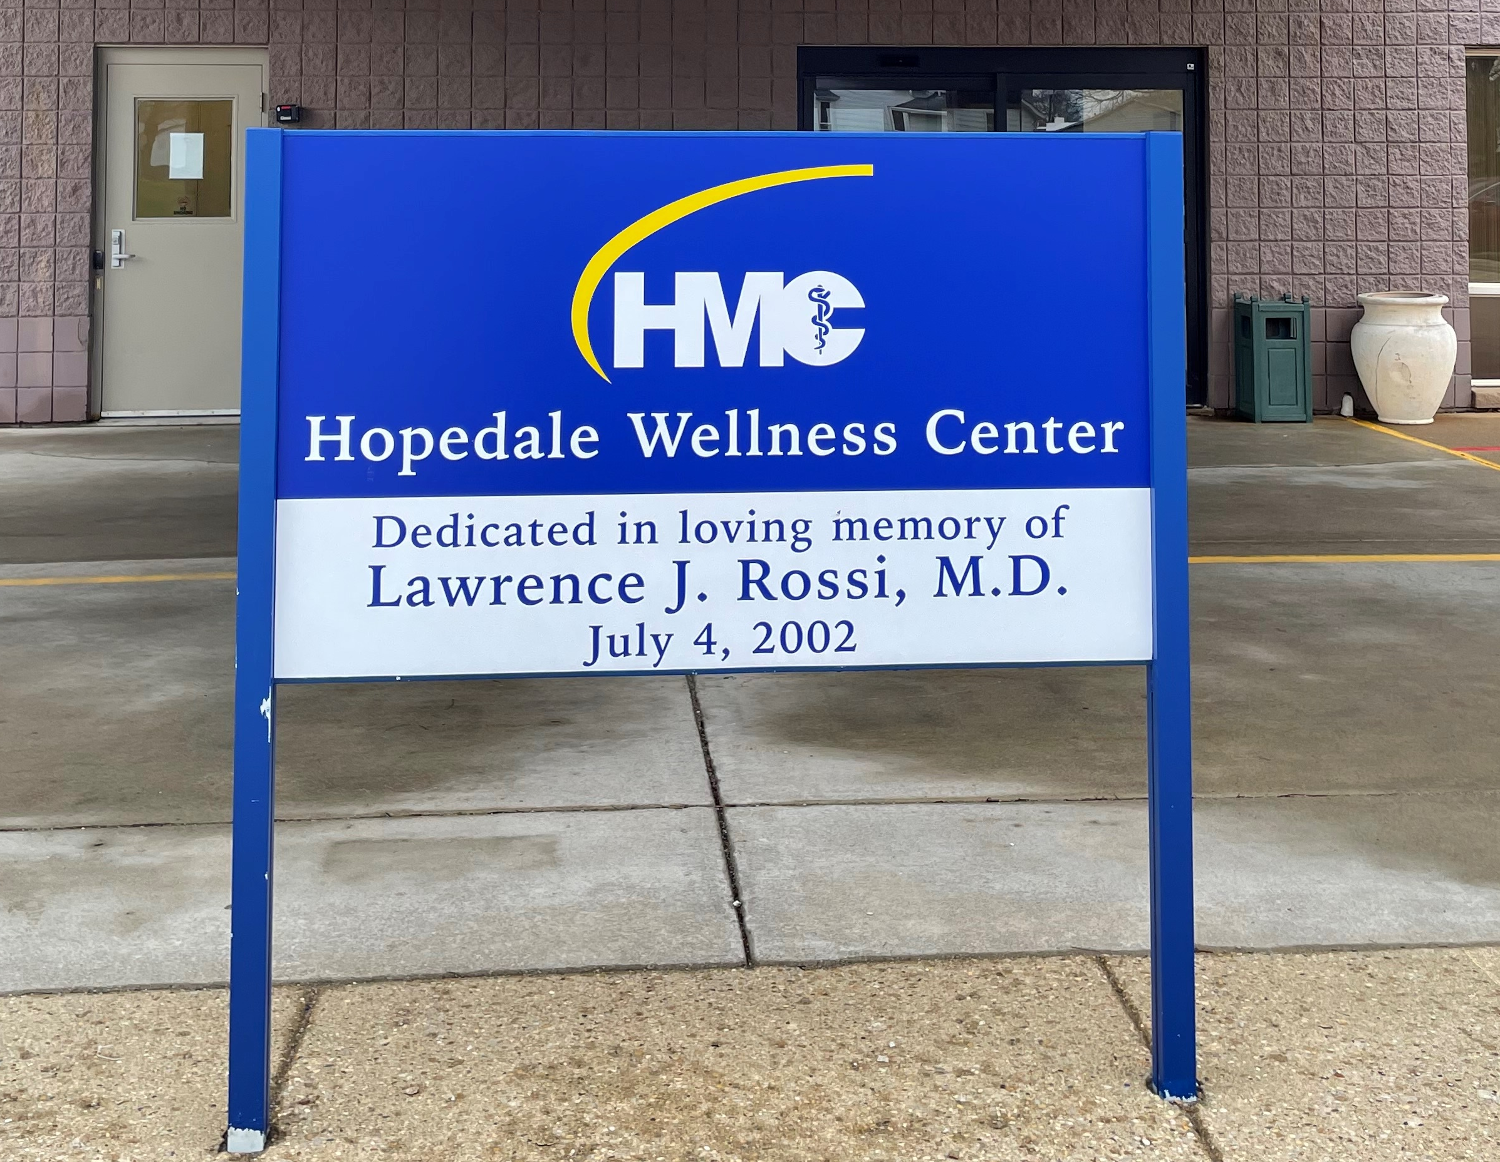
Why a Wellness Center in a rural area?
Answer: Hopedale Medical Complex Continuum of Care Model.
Dr. Rossi wanted a place where local community members could go to “Be Well”.
Have a place where the community members can gather and exercise to prevent injury or illness.
Continue to provide the healthcare resources for HMC patients once discharged from care.

Slide 3
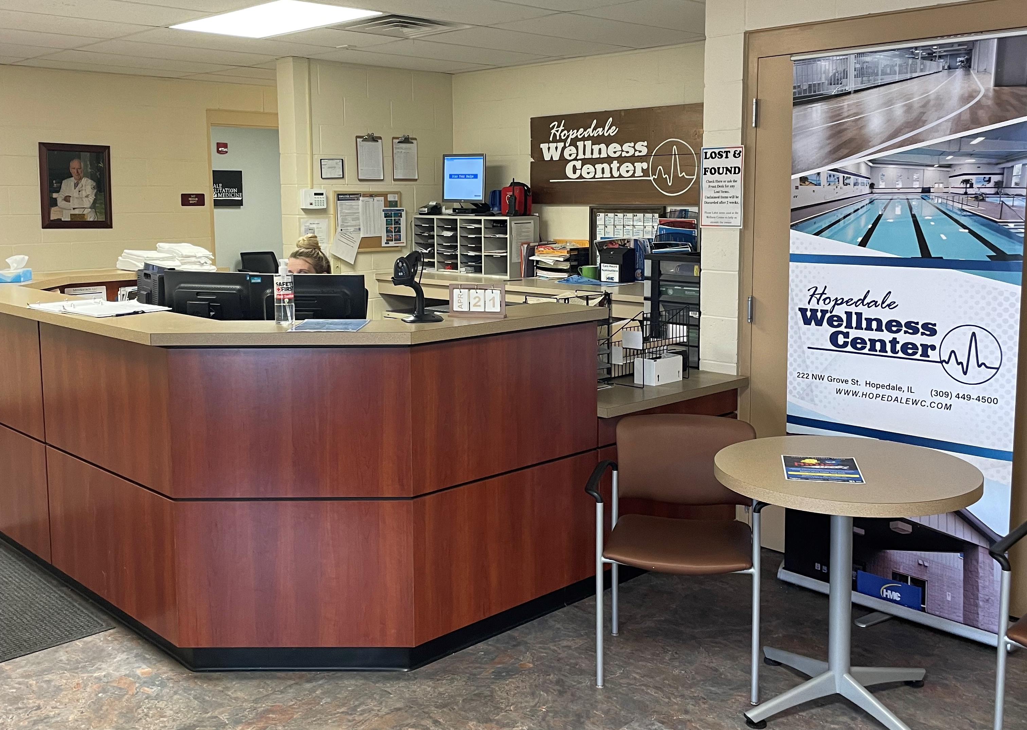
Wellness Center Layout
Wellness Center Lobby
32,000 square foot facility
25 meter lap pool
Therapy pool
Fitness Floor
Gymnasium
Massage Therapy Suites
Physical Therapy Department
Cardiac Rehab Department

Slide 4
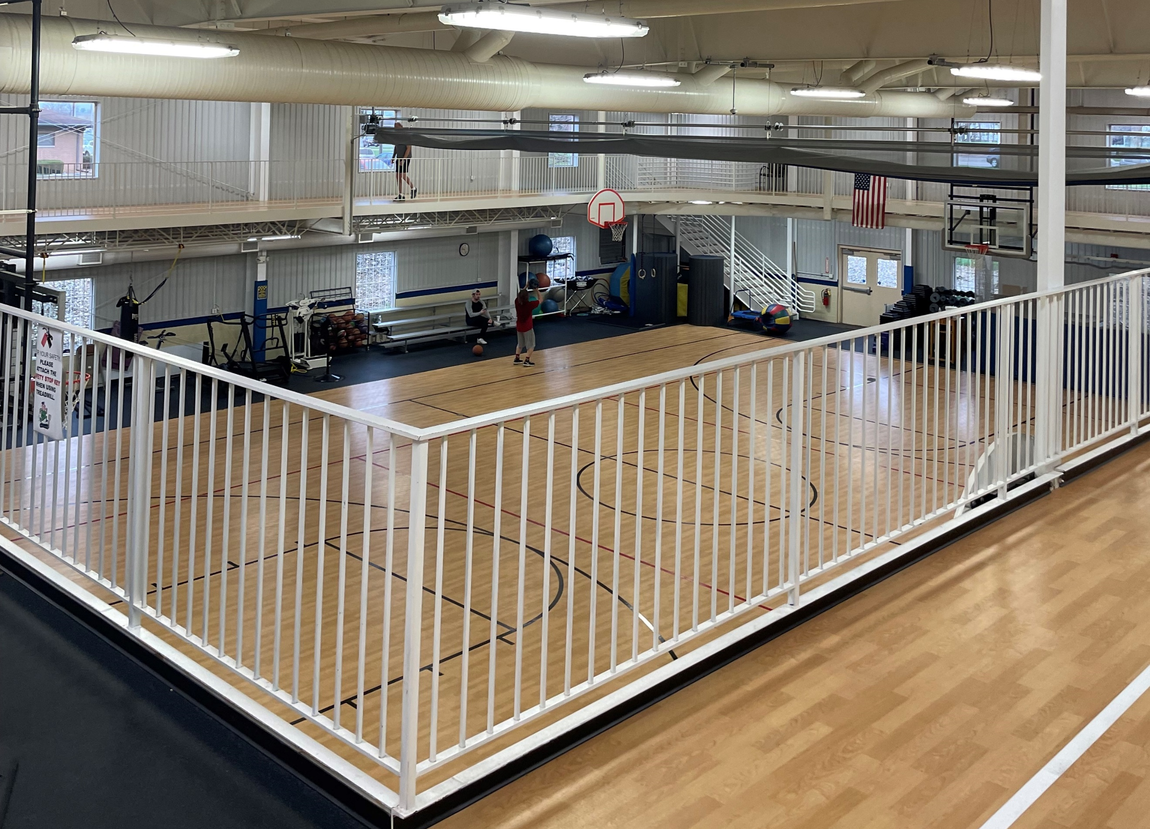
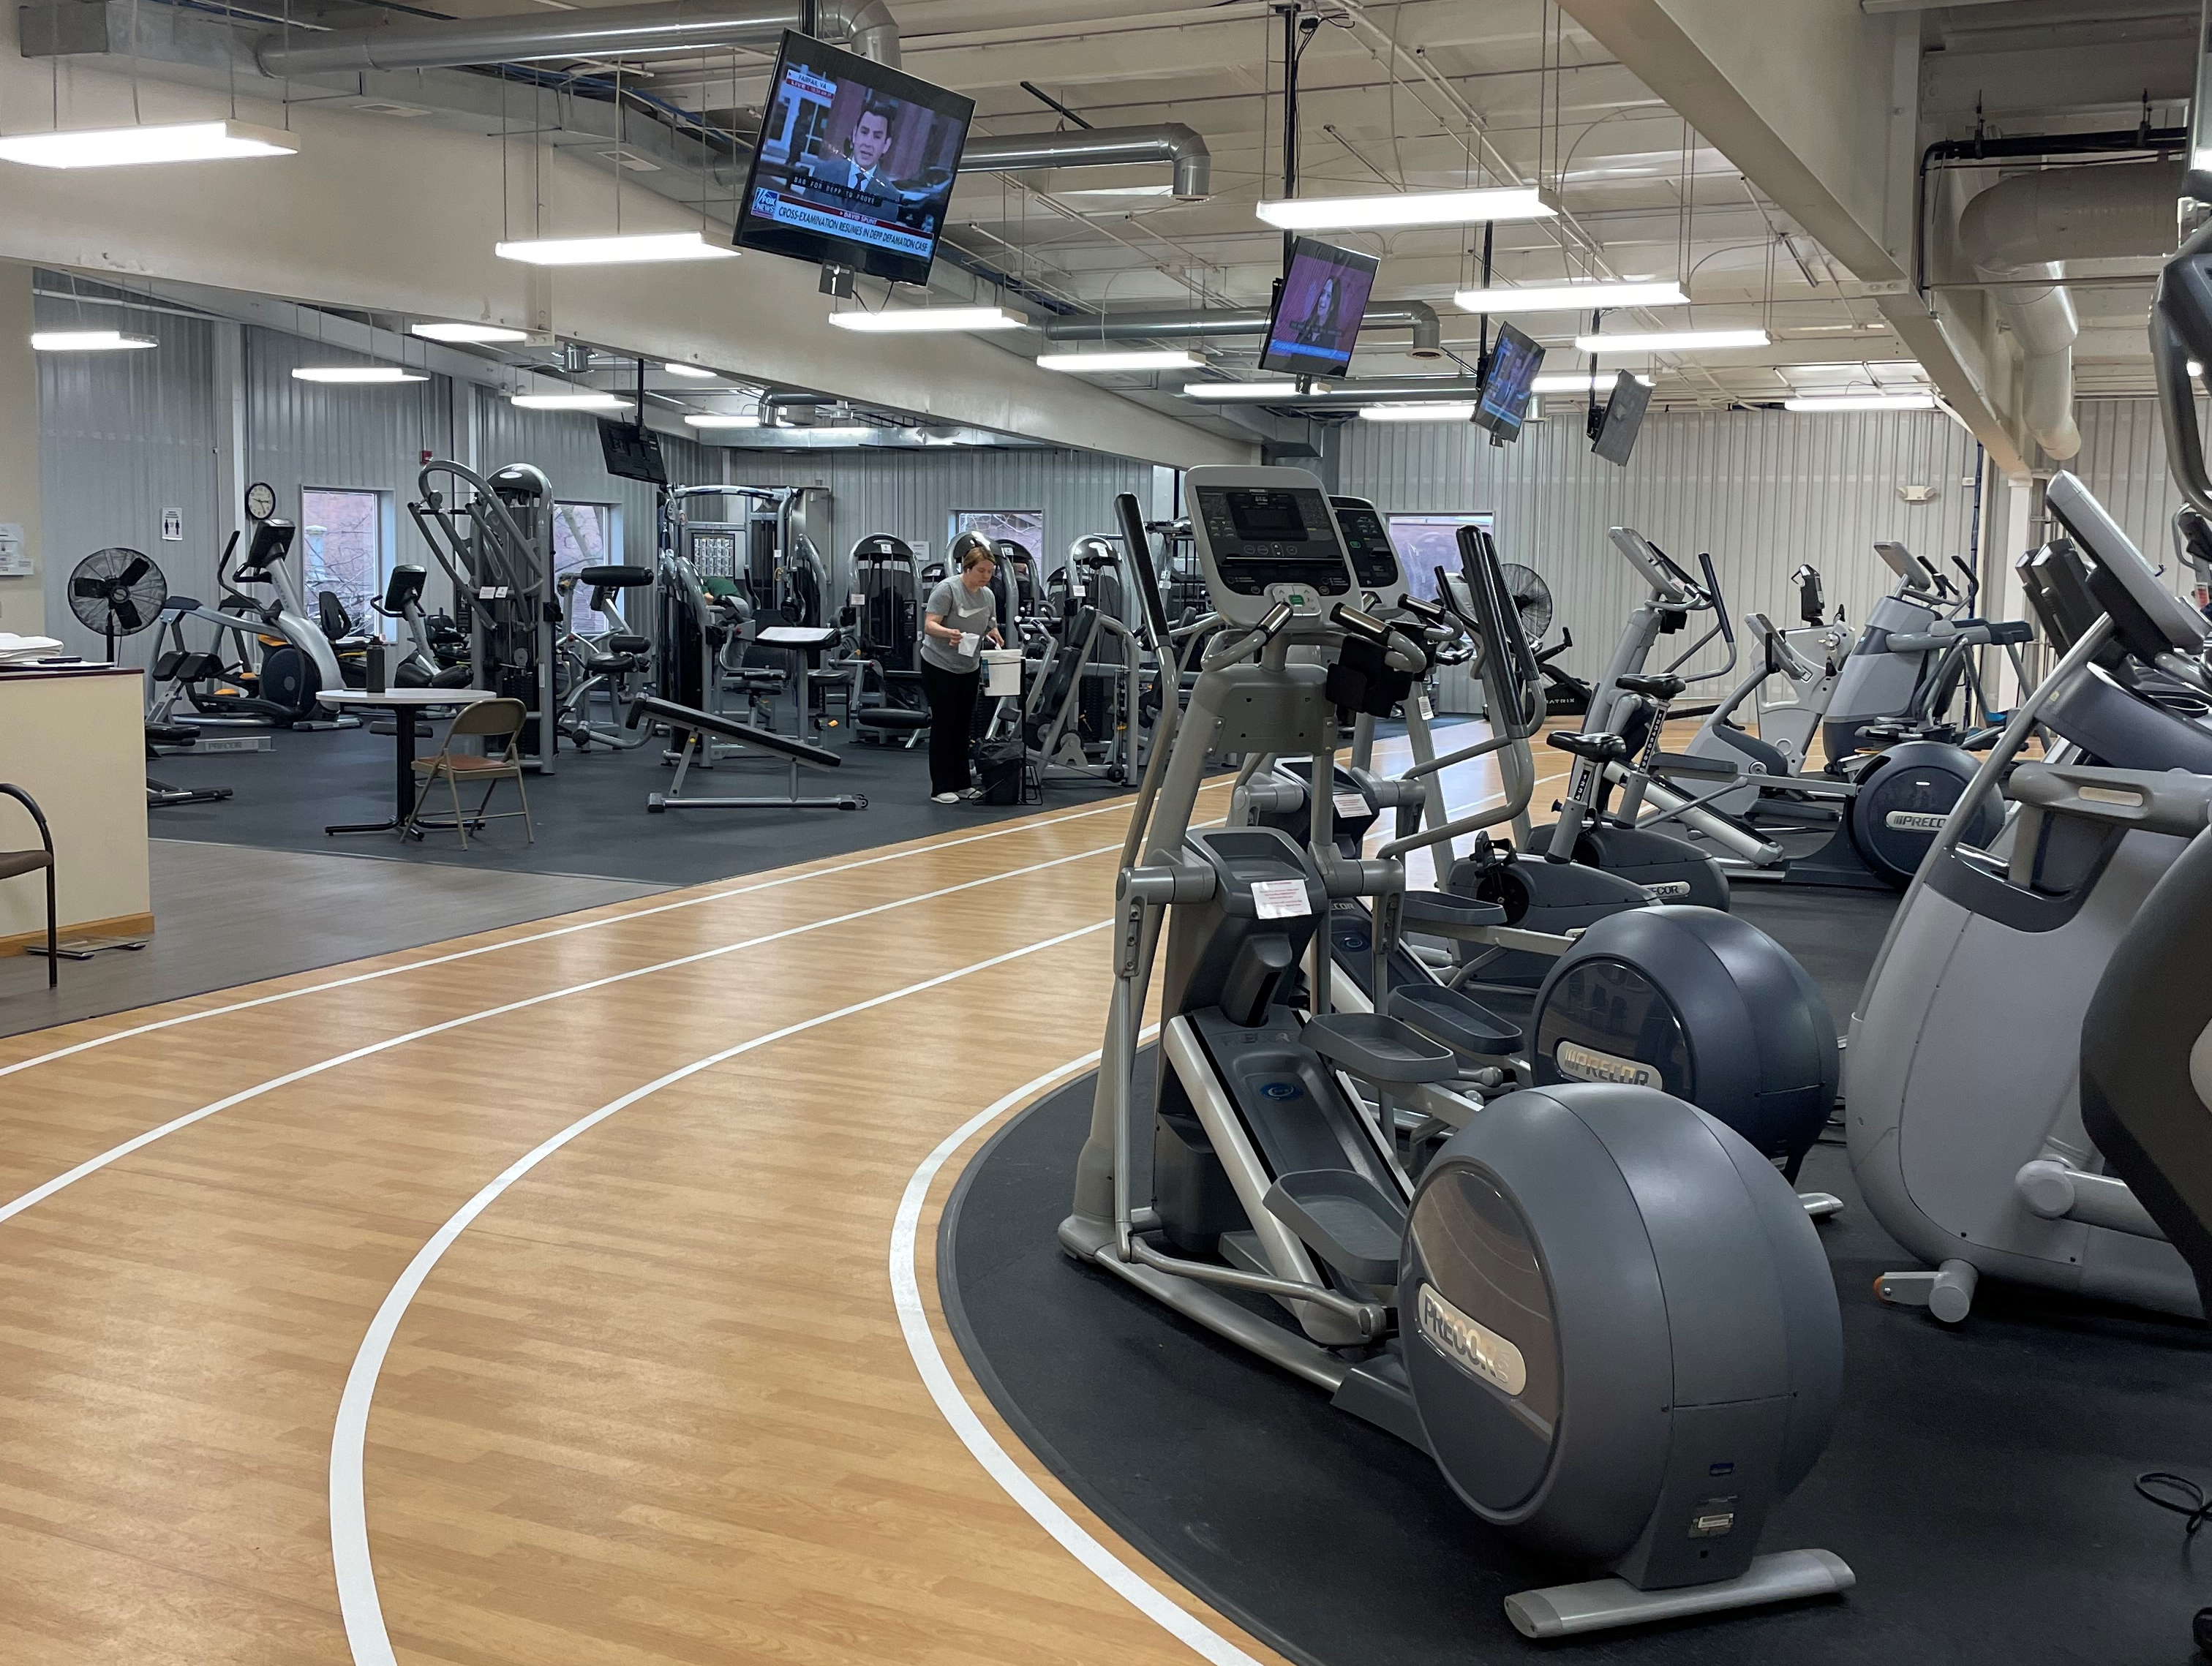
Wellness Center Services
Wellness Center Gym & Fitness Floor
Massage Therapy
Physical Therapy
Cardiac Rehab - Phase 3
Pulmonary Therapy
Orthopedics
Gymnasium and Free Weights
Fitness Floor Machines & Cardio Equip.
Aquatics
Health and Wellness Services
Community programs for all ages

Slide 5
HWC Collaboration Need
Establish community partnerships in order to enhance services for both entities for stronger and healthier community.
Purpose of Need
Facilitation of Need
Enhance communication between the facility and the community.
Receive input from community members as to what goods/services they would like to see from the Wellness Center.
Establish financial partners / doners to maintain operations for the community.
Develop professional relationships with community organizations.
Develop an advisory committee of community members from multiple organizations and ideals.
Have a committee with no more than 12 members.
Host a 90-minute meeting at the Wellness Center once a quarter of the HMC fiscal year.

Slide 6
HWC Collaboration Need
Outcomes
Desired Outcome
Desired Internal Outcome
Develop professional relationships to address community health and wellness needs.
Work together to promote each others' goods/services.
Development of Wellness Center programs in order to meet the needs of our communities.
Improve the fiscal stability of the Wellness Center for years to come.
Promote specialty services of the Hopedale Medical Complex.
Continue to build community engagement and trust.
Fulfil the dreams that Dr. Rossi had for the Wellness Center for years to come.

Slide 7
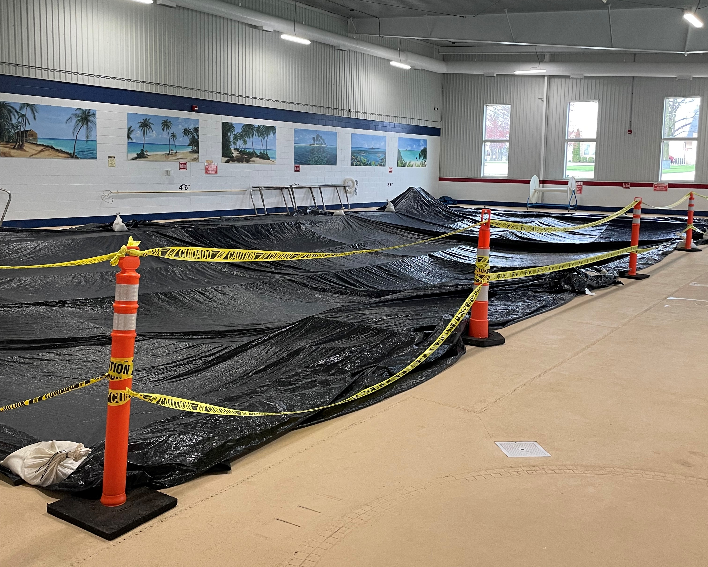
Advisory Committee (in development)
Building Community Through Collaboration
Greg Eberle, HWC Manager
Courtney Long, HWC Program Coordinator
Jennifer Hubert, Community of Tremont
Mark Walsh, Community of Delavan
Steve Leesman, Community of Minier
Kathy Weinzieral, Helping Hands Community Center
Kim Litwiller, Tazewell County Health Department
Laura O’Donnell, Olympia Superintendent
Sean Berry, Tremont Superintendent
Hopedale Township Council Member

Slide 8
Where do we go from here…
Action Plan
First meeting is being scheduled in the last quarter of the fiscal year in preparation for FY23. (mid May).
The committee will be sent a survey via electronic means prior to the meeting to assess Wellness Center operations and how it will impact their organization.
Once the meeting is in session, we will follow an itinerary of discussion.
Throughout the quarter, we will have constant communications via email, phone or an electronic platform.
Duration of committee will be one fiscal year and then the effectiveness will be reported out and assessed for FY24.

Slide 9


Thank You.
Greg Eberle ATC, CES Wellness Center Manager
309.449.4533
geberle@hopedalemc.com
www.hopedalemc.com

