Slide 1

Driving Performance Improvement Through
Occurrence Reporting
Implementing SQSS
2022 ICAHN RURAL HEALTH FELLOWSHIP PROJECT
JOANNA ELLIOTT | MARSHALL BROWNING HOSPITAL

Slide 2
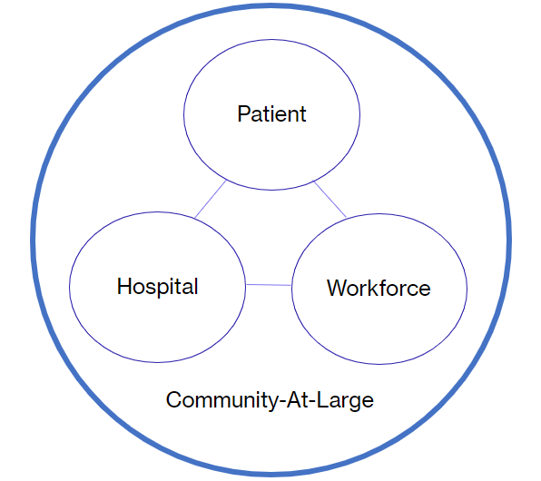
Benefits of Well Managed Occurrences
Patient
Less risk of medical errors and harm
Fewer complications and costs associated with care
Greater confidence in hospital
Hospital
Fewer resources taken from direct care of patients to manage incident reports
Fewer losses associated with the consequences of Never Events
Fewer stories that can harm the hospital's reputation in the community
Improved survey outcomes
Workforce
Improved collaboration between departments and staff bringing issues to closure
More time available for direct patient care
Easier process for reporting risks as great catches and near misses
Community-at-Large
Stronger confidence in hospital driven by fewer stories of error and harm

Slide 3
Project Purpose:
Retool the Hospital Risk Management Program to...
Increase identification of risks that could result in harm to our patients, workforce and the hospital itself
Migration of current incident reporting program from identification of risks as primarily incidents after the fact to great catches and near misses with a greater focus on risk prevention
Build a stronger relationship between risk and quality management activities to reduce the potential for harm producing errors related to stronger quality management activities
Increase involvement of frontline managers in investigative and corrective action planning activities
Decrease involvement of risk manager in day-to-day investigative activities and more involved in risk prevention opportunities
Transition risk prevention and management activities to support an effective quality program with a special focus on the creation of a Just Culture

Slide 4
Measurable Outcomes: July 2021—July 2022
Employees will report occurrences across all major areas of risk that impact our patients and hospital at large
Demonstrate measurable increases in occurrences being reported as great catches and near misses
To have 80% of occurrences closed or with an improvement plan in place within 30 days of the identified event
A downward trend in occurrences being identified as incidents after the fact due to stronger prevention and QA activities
Employees report a greater level of comfort and satisfaction with their involvement in the quality and risk management program, the outcomes it produces and the fairness in which it is operationalized

Slide 5

From Paper Reporting
PCIR Form: Paper Occurrence Reporting
Underreporting
Lost reports
Delayed receipt of report
Delayed corrective action
Not shared between departments
Filed in drawer never to be seen again
No full circle closure
Employees do know what happens to the report once submitted
Manual tracking and trending

Slide 6

To Electronic Reporting
SQSS (Strategic Quality Support System): Electronic Reporting
Easily accessed by any employee
Timely notification of Manager / Key Stakeholders and Risk Manager
Just-Do-Its offer 24/7 collaboration with off-shift employees
No waiting to implement investigations and improvements
Collaboration / Employee engagement
Improved trending
Centralized hub of communication
PI/QI can be directly created from occurrence reports
Employee is notified when report is reviewed
Faster notifications make for timely improvements

Slide 7
July 2021
Risk Manager enters occurrences in SQSS as received from departments
Aug. 2021
QAPI Mtg overview of Occurrence reporting How-to for managers.
Some Managers already adopting the process and educating staff.
Sep. 2021
WHAT??!! More COVID distraction creates temporary roadblock....
Oct. 2021
Leadership team agrees that all occurrence reporting will be electronic by Dec. 31, 2021
Nov. 2021
Pharmacy creates a Performance Measure populated from scanning error occurrence data. 12 occurrences in total.
Dec. 2021
1st visual illustration of occurrences presented to Hospital Board
Jan. 2022
Just Culture severities added: Human Error, At-Risk Behavior, Reckless behavior
Feb. 2022
Pharmacy PI proves effective! Occurrences in scanning errors decrease from 12 down to 1! Staff verbalize satisfaction with improvement.
Mar. 2022
More staff using SQSS for mass assigned tasks will lend to greater comfort in system
New QAPI plan approved
June 2021
SQSS (Strategic Quality Support System) adopted.
All occurrence reporting is paper

Slide 8
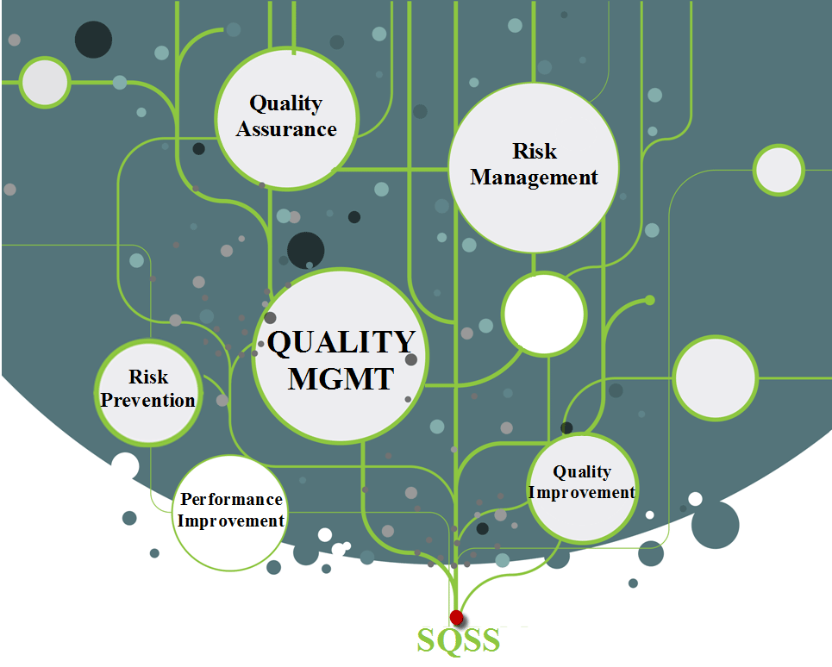
What is SQSS?
Strategic Quality Support System
A web-based tool designed to support efficient and effective management of a wide range of quality activities.
  Occurrence Reporting and management
  Quality Improvement
  Performance Improvement
  Task management
  Document Control
  Policy & Procedure Management
  Survey Readiness and Tracers
  Maintenance work-orders
  Visual Dashboard
  At-a-glance reports
  Transparent Quality management that promotes collaboration
Darlene D. Bainbridge & Associates, Inc.

Slide 9
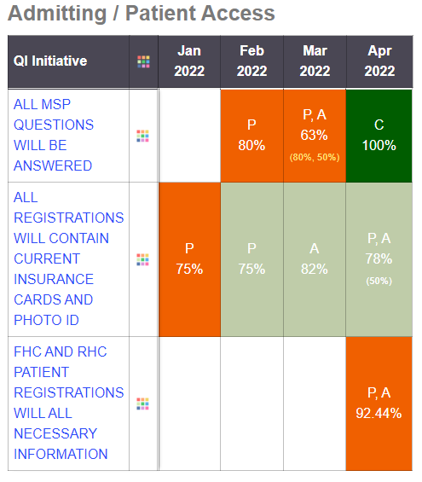
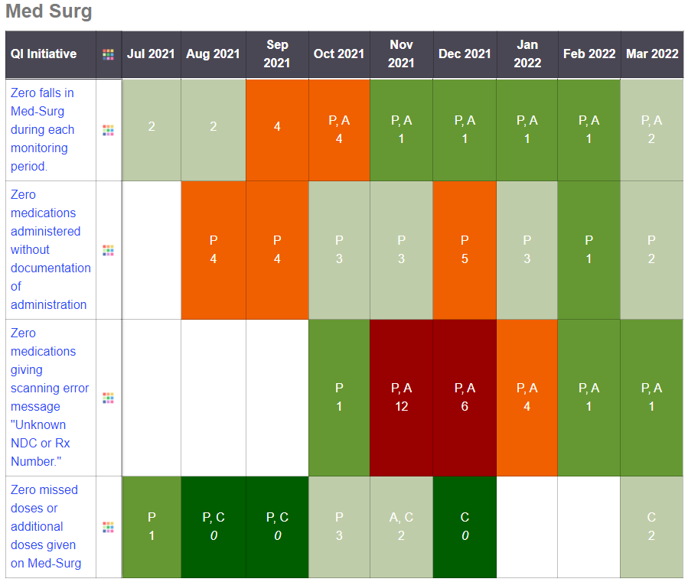

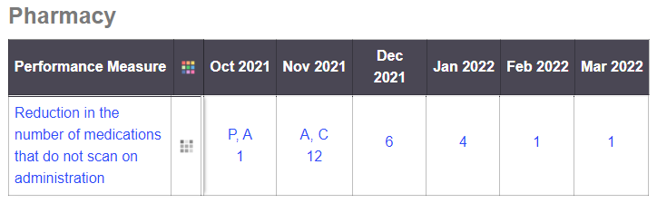
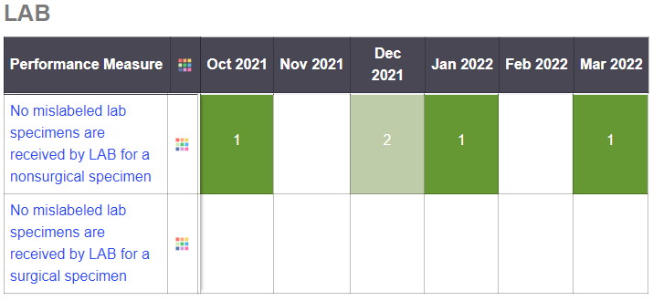
Current Successes!

Slide 10

Teach a man to fish....
How can we fix it if we don't know it's broken?
Questions?

Slide 11
GRATITUDE and THANKS!
ICAHN for the fellowship program. I am honored for the opportunity to participate.
Nancy Allen for listening, being a great sounding board, book club partner and for believing in my passion for this project! You were right...occurrence reporting leads to problem solving that supports our mission and benefits our community!
Larry Spour for asking me "Why not now?" when I thought the timing might not be right for the fellowship.
Darlene Bainbridge for her willingness to guide me, generosity of her time, knowledge and assistance with getting this project off the ground. SQSS is a gamechanger!

