Slide 1
Mercyhealth Hospital Project
Tyler Killpack

Slide 2
Core Statement
For this project, I am developing timelines and accountability to operationalize a new hospital to be completed in Spring of 2023.
This project will benefit siloed departments that need project direction for successful opening. E.g. I/S, Nursing, Physician Recruitment, Legal, Supply Chain, and Construction.
This project will change well-meaning effort into guided strategy by centralizing communication and direction.
And benefit the Community!

Slide 3
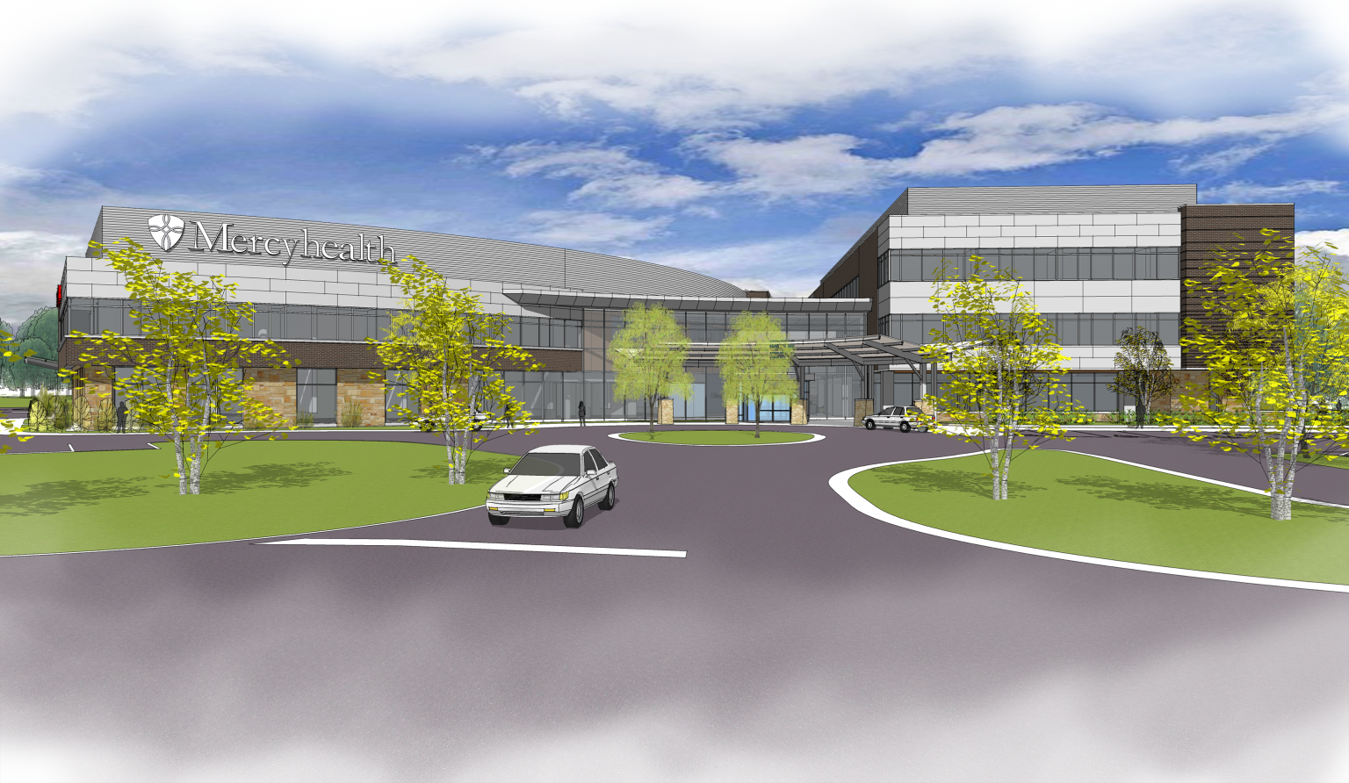
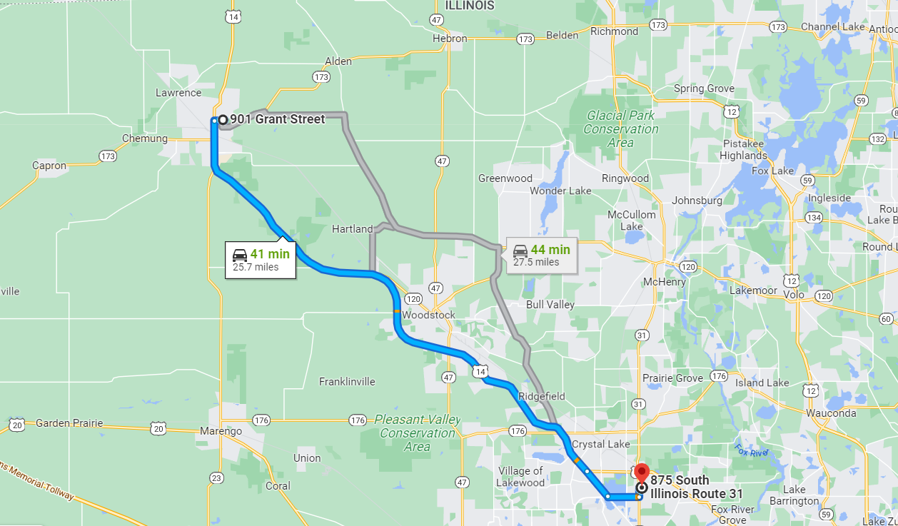
Background

Slide 4
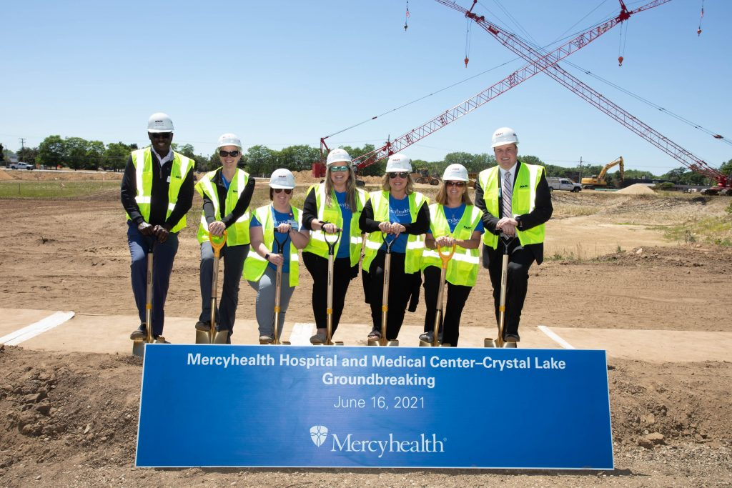
Deliverables and Timeline
Medical Equipment
Staffing
Physician Recruitment
Financial and Clinical Applications
Licensure and Accreditation
Targeting a Spring 2023 Opening

Slide 5
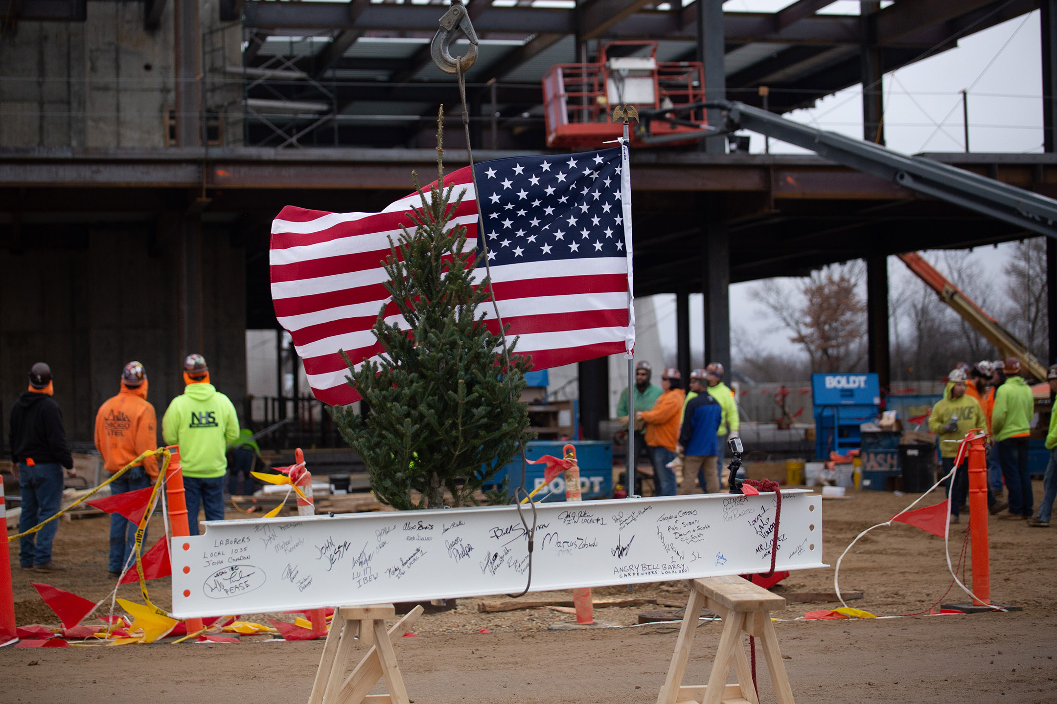
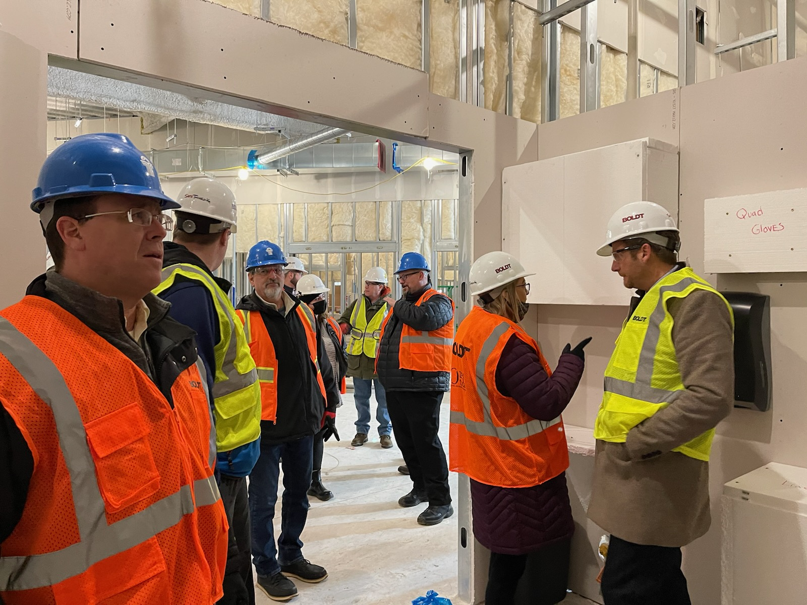
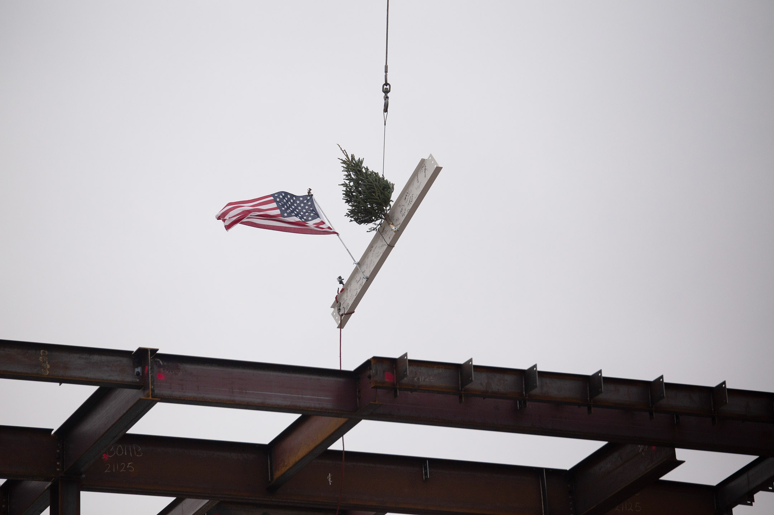
Stakeholders and Buy-In

Slide 6
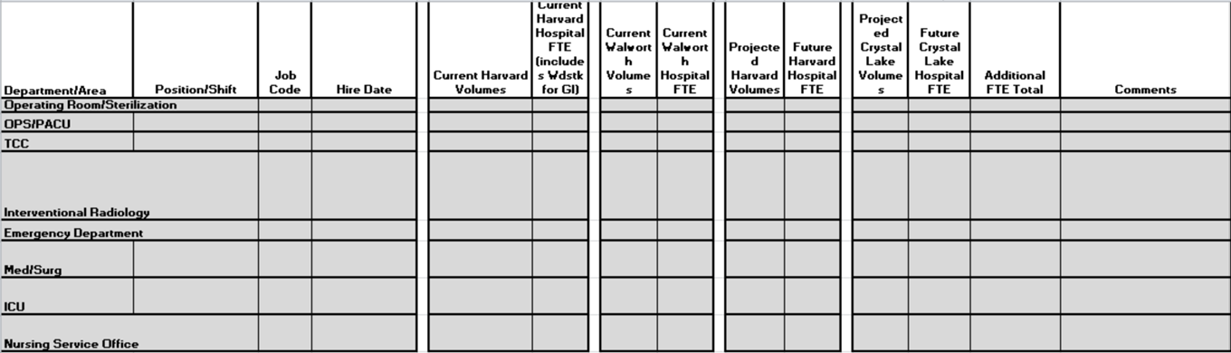
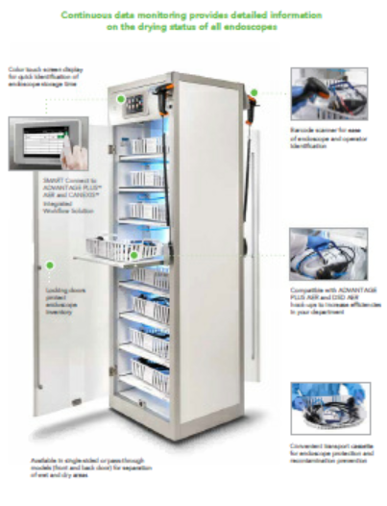
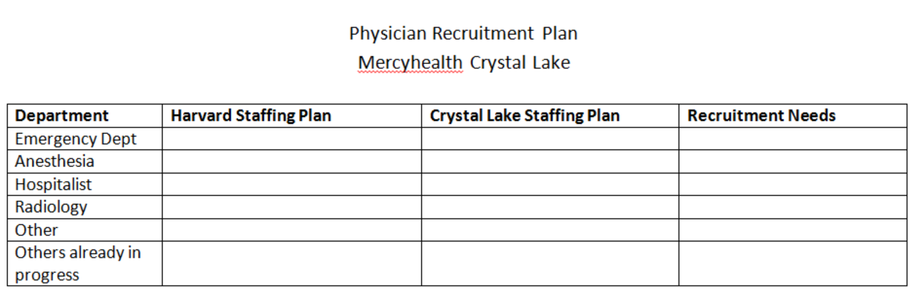
Activities

Slide 7
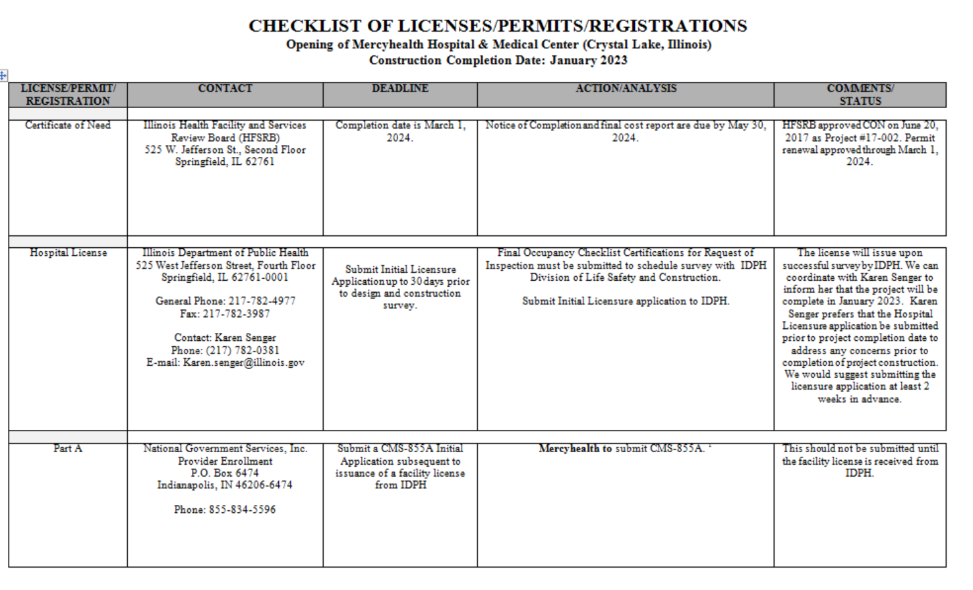
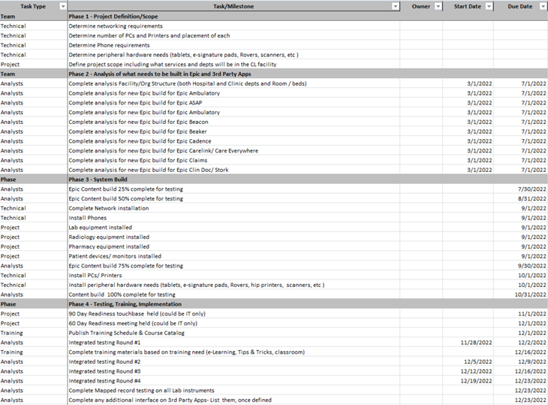
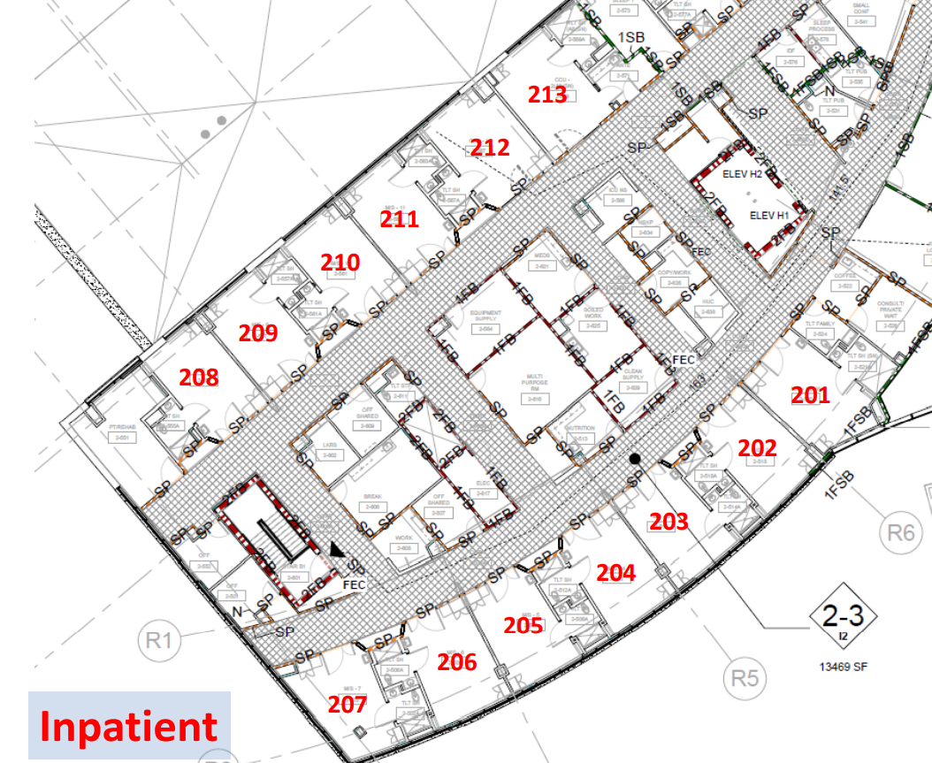
Activities

Slide 8
Success/Outcomes to Date
Successfully Completed and Approved Staffing and Physician Recruitment Plan
Communication is Centralized and Roles are Identified
Breakout Groups are Reporting Accountability
Opportunities for Staff and Community Engagement
Overall Project Timeline is on Schedule

Slide 9
Barriers
Adapting to Construction Challenges
COVID-19 Surges
Everyone’s “Regular Job”
Staffing Shortages

Slide 10
Next Steps
Training, Orientations, Occupancy
Marketing Efforts
Continuation of all Groups Mentioned Previously
Phone Numbers
Managed Care Contracting
Non-Clinical Applications

Slide 11
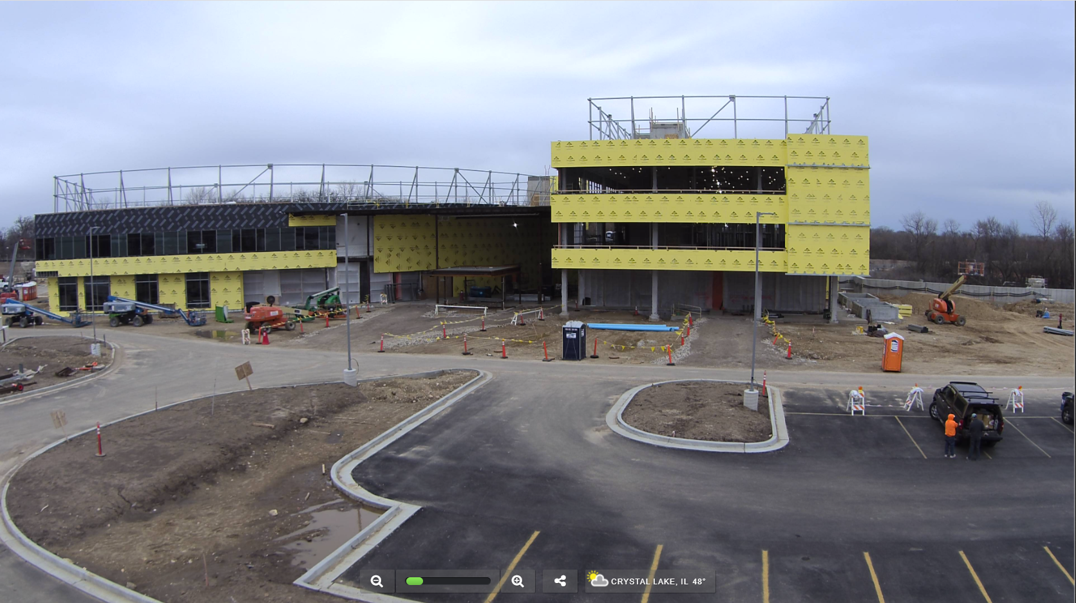
Questions?

