Slide 1

Establishment of a non-CAH Physical Therapy Practice at Sycamore Pain and Wellness Clinic
Rural Health Fellowship Project 2022
Morgan Kincaid, DPT, CLT

Slide 2

Core Statement
Horizon Health is developing a physical therapy practice at Sycamore Pain and Wellness Clinic (SPWC) to help patients obtain comprehensive care, continuity of care, and improved access to PT services.
Notes:
Building purchased by Horizon Health for Sycamore Pain and Wellness group, who started practice in December 2021.
Pain management group looking to provide comprehensive care to their patients
Ample space for additional service lines at that location
Continuity of care, communication between providers
Improved access to PT services
Capture PT visits ordered at our Terre Haute Specialty Clinic
Our services
Interventional Pain Management
- Nerve Blocks
- Spinal Cord Stimulation
- Pain Pumps
- Other Specialized Procedures and Pain Injections
Behavioral Health and Mental Health
Psychiatric Medication Management
Opioid Management
Medication Assisted Treatment (Suboxone)
Osteoporosis Management
Nutritional Pain Management
Weight Management
Tobacco Cessation

Slide 3
Timeline/Deliverables
Guidelines
Guidelines for billing as non-CAH
Supervisory Guidelines
ROI
Payor Mix
Expected Patient Volumes
Staffing
Obtaining IN License
Clinical Skills needed, PT vs. PTA, Support Staff
Reimbursement Structure
Startup costs
IN practice act
Notes:
Guidelines
First looking to see if it is even possible, how is that billed, is that a separate entity or part of HH? Hospital-based versus Clinic. What we found is we can bill as a clinic under our own NPI numbers (means it must be a PT?). Set up more like a private practice.
NP or MD need to be present in building
IN practice act- Direct Access is more lax than IL, but spinal manipulation is not allowed
ROI
Payor Mix-40% Medicare, 30% Commercial, 30% Medicaid

Slide 4
Stakeholders and Buy-In
VP of Strategic Development, CEO, and CFO
Providers and Clinic Manager of SPWC
PT staff
Coders/Billers
Notes:
Providers-have to value service enough to share their space, be willing to share front desk staff to start
Coders/Billers, including consultant

Slide 5
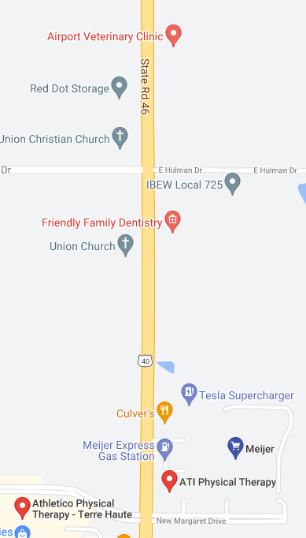
Assessing Need/Support
Month | Number of Referrals
September (No SPWC) | 27
October (No SPWC) | 30
November (No SPWC) | 30
January | 79
February | 66
March | 111
Notes:
Look at Competition, 2 PT clinics in the area

Slide 6
Reimbursement Structure
Payer | CAH | Private Clinic
Medicare | 101% of cost | 28.75-40.11/unit
Medicaid | $511. | 20.57-25.12/unit
Commercial | Contracted rate | Contracted rate

Slide 7
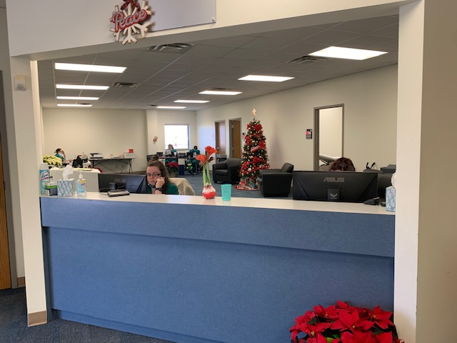
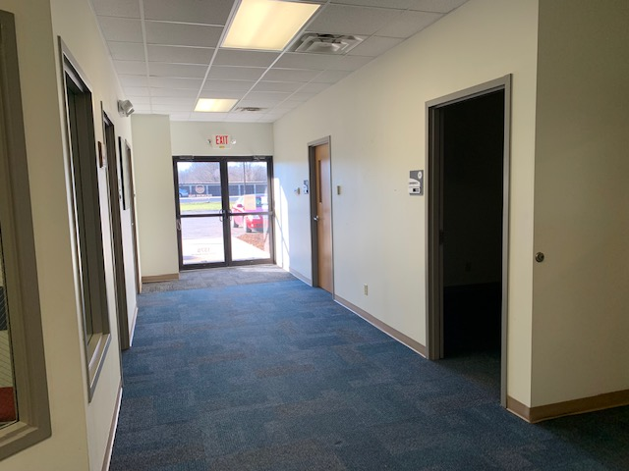
Space/Equipment Needs
Notes:
Accessibility to clinic, adequate space, construction

Slide 8
Successes and Barriers
Provider support
Staffing opportunities
ROI
Space
Timeliness obtaining IN licensure
Construction progress
CAH vs. Clinic, knowledge on guidelines
My timeline vs. administration’s timeline

Slide 9
Outcomes
Awaiting IN Licensure to proceed with NPI numbers and credentialing
Awaiting final construction plans to ensure space
1 PT Staff committed to 3-5 days/week, 1 potential PT candidate if volumes are present
Equipment List prepared/ready
Referrals are there from SPWC, Dr. Bollenbacher, and Dr. Kempegowda
Current EMR is going cloud-based, will use the same EMR

Slide 10
Next Steps
Set-up Athena department and interface, Casamba EMR
  Determine registration, billing, and coding differences
Insurance credentialing with top commercial insurances and IN Medicaid
Train staff
  Front desk staff on insurance auths
  Clinical staff on clinic set-up, productivity, IN practice act
  Educate providers on services provided at this location
Order PT equipment, desks, IT needs, etc.
Anticipated opening 3rd or 4th quarter

Slide 11
Q & A

