Slide 1

Remote Physiologic Monitoring
New Service Line addition 2022

Slide 2

Purpose
Remote physiologic monitoring is a technology to enable monitoring of patients outside of conventional clinical settings, such as in the home or in a remote area, which may increase access to care and decrease healthcare delivery costs. This service, coupled with the Mobile Integrated Health team, expands our patient services in the home by using nurses, APRNs and MD for home monitoring of patients
https://youtu.be/eS4OZZuutfo

Slide 3
Goals
The goal of RPM service is for better control of patient’s chronic medical conditions and to prevent unnecessary or repeated emergency room visits and re-hospitalizations. RPM allows the provider to monitor the patient’s vitals from their office and change medications appropriately.
Fund a much-needed and well-received service line of MIH

Slide 4
Stakeholders
Patients with a chronic medical condition such as hypertension, diabetes, chronic obstructive pulmonary disease (COPD), congestive heart failure (CHF), or COVID-19 can enroll in the service. Commonly, the collaboration with our MIH team and the case management/care coordinators will help channel the referrals into the program and help with eligibility. Provider referral is preferred to help better collaborate and monitor the patients progress.

Slide 5
Objectives
The service consists of a nurse and other medical personnel who have expanded their practices to include in-home visits.
They work collaboratively with nurse practitioners/physicians to provide oversight on each patient’s medical management.
RPM will allow patient’s and providers greater access to health care. RPM will allow patients to be greater connected to their health care professionals and help decrease healthcare disparities.
In turn, RPM will help better manage chronic ailments and will allow providers to better treat their patients.
Each RPM patient will receive in home equipment that is 4g based and will allow them to take their vitals including blood glucose and weights. Those results will then be downloaded into the patient’s chart for the care provider team to evaluate. The equipment that will be provided depending on the patients care plan may include a blood pressure cuff, scale, pulse oximeter, and glucometer.

Slide 6
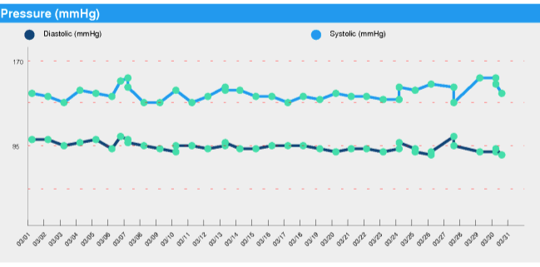
Process

Slide 7
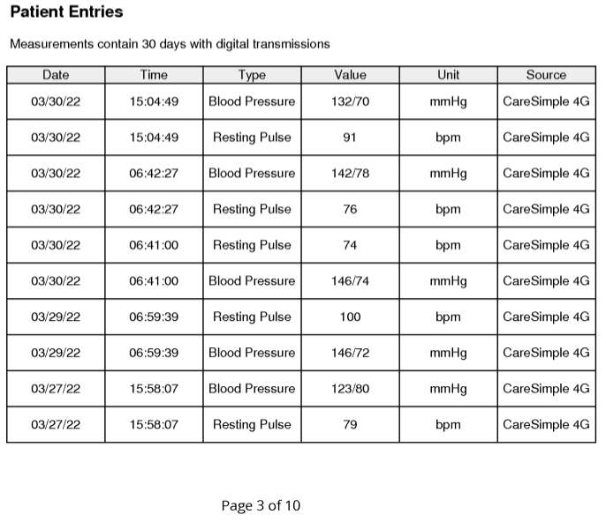
Process

Slide 8
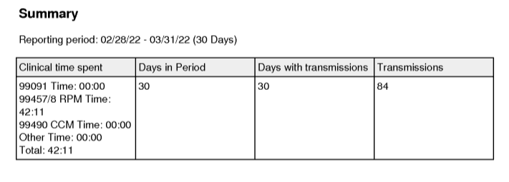
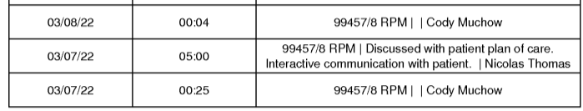
Process

Slide 9
Milestones
What | By When
Approval of MIH as new dept with FTE support | 1/1/2022
Signed contract with RPM vendor | 1/7/2022
Build of new dept/Athena dept/test integration | 1/18/2022
FTE onboarding | 1/24/2022
Weekly onboarding RPM calls | 1/10-?
First RPM patient enrollment | 2/17/2022
First charge entered | 3/24/2022

Slide 10
Summary Budget
To offset the cost of the FTE and capital equipment for the MIH program, a contract proposal for the RPM program was reviewed. If MIH team can enroll 30 patients per month onto the RPM platform, the revenue generated will offset the cost of the MIH program.
They have 28 patients in the first two months of operation so we are looking for MORE!!!!!
We have also received SHIP grant funds to help offset some of the start up costs to better show revenue streams this year.

Slide 11
Conclusion
Better access for patients
Decrease unnecessary ER visits
Decrease re-admission penalties
Help patients meet health goals
Support MIH service (in case need for hospital capacity spikes)
Technology-driven healthcare
Helps support community infrastructure
Allow for expansion as service/needs/patient areas expand

