Slide 1
Emergency Room tracking and Scheduling
Fellowship Project
Midwest Medical Center
By Katie Meusel

Slide 2
Project Core Statement
For this project, I am developing a process for patients who have been seen in the ER for follow up appointments in our clinic(s).
This project will benefit patients who have repeat visits to the ER, to have them establish with a provider. This will ensure patients have adequate follow up care within the clinic instead of ER.
This project will help create a standard of work for our team at Midwest Medical Center to accurately schedule follow up appointments and to assist patients to gain a better understanding of the need for follow up care.

Slide 3
Whats the problem?
Patients are being seen in the ER, and not having the needed follow up
  Example: Patient had sutures placed in ER, does not schedule f/u appt; calls clinic three weeks later saying sutures need removed, but sutures are now grown into patient’s skin.
  Example: Patient has no Primary Care Provider, but needs to be seen for Congestive Heart Failure. Walks out of ER without making appointment, and ends up in ER again within the week.
  These are just two examples. Many more!

Slide 4
StEPS to a Solution
Interviews were completed with ER/Admitting/Clinic departments.
LEAN Diagram- issues laid out by ER/Admitting/Clinic. Issues are inconsistency with communication from ER/RN to admitting to make appt; Unwanted Appointments in clinic and No Shows within Clinic.
With a deeper dive of the “WHY”, inconsistency is the biggest issue.
Interviews with staff and discussions with Assistant Director Of Nursing have taken place, and several workflow adjustments have been made.

Slide 5
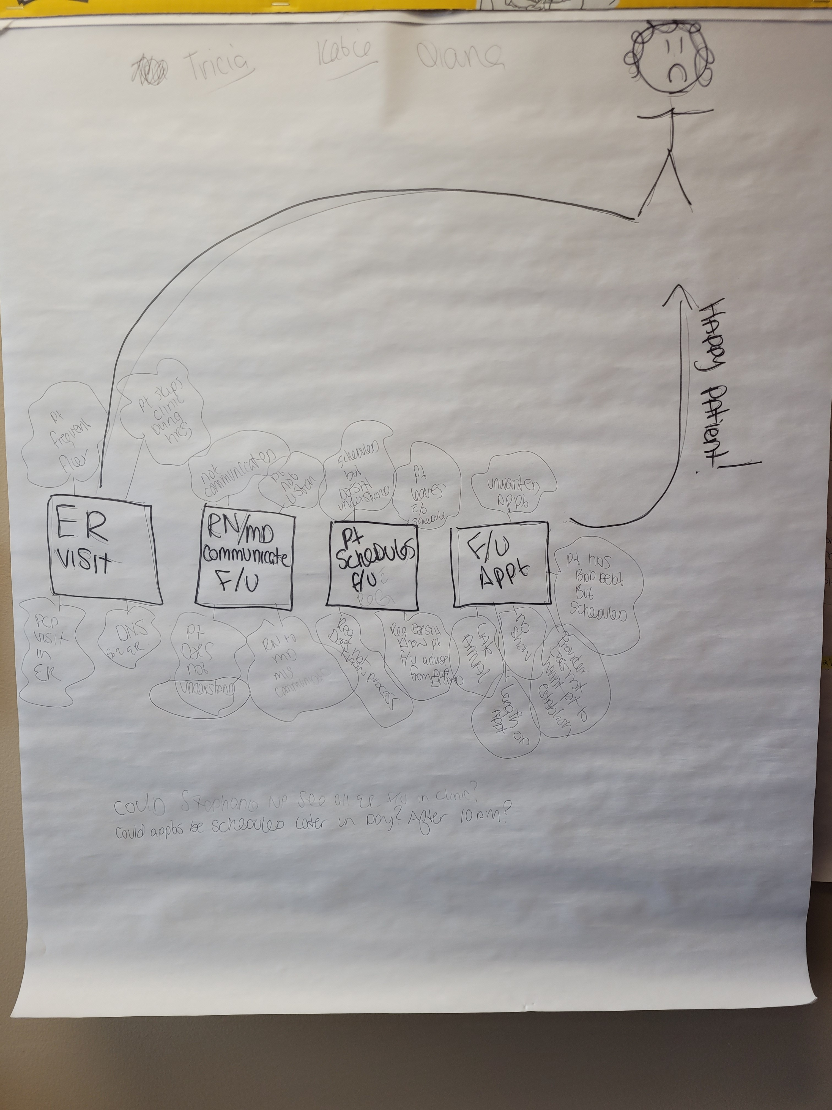
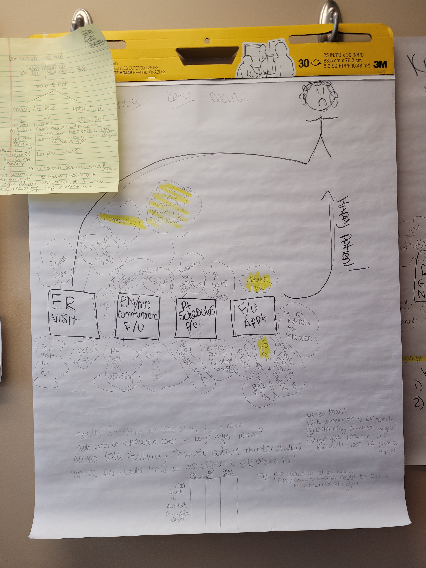
What is the problem?

Slide 6
Changes Made
February 2022: LEAN A3 Diagram completed.
February 2022: Interviews of staff (ER/Admitting/Clinic)
3/10/22: Inconsistency biggest issue- LEAN review discovery!
3/15/22: ER call back report did not have PCP listed- this has been added. This has been reviewed with ER staff, and will be tracked for one month for improvement.
3/15/22: Clinic tracking daily ER visit report per PCP, and tracking how many of those patients have ER F/U in clinic, vs how many listed as F/U PRN. This will be tracked until further notice.

Slide 7
Goals:
Current Goals: 48 Hour Call back list in ER will have PCP listed. If patient is not doing well when 48 call back is completed, RN in ER will connect with clinic WITH patient on line, and schedule ER follow up. This will be a new workflow.
Trying to “cut out the middle man” and removed the Admitting team from this workflow, as they can help, but should not be concentrated on them.
Clinic will track % of completed ER follow ups, and find in the next month what percentage is missed, that we can improve.

Slide 8
March 14-31st Data compared to April 1-15th data

Slide 9
Conclusion
ER visit tracking and follow up visits is a sustainable process that hopefully with improvements will show better quality and outcomes for patients that come to ER.
Tracking each month shall show improvements/concerns and allow for real time process improvements for better patient outcomes.
This process will be ever changing and evolving, as the needs of patients constantly changes. As we all know, Healthcare is constantly changing, and we as healthcare professionals need to adapt with it!

