Slide 1

Outpatient Suicide Risk Assessment Implementation
Emily Bailey, RD LDN
Director, Clinical Operations
Taylorville Memorial Hospital
2021-2022 ICAHN Rural Health Fellow
Notes:
I’m Emily Bailey, Director of Clinical Operations at Taylorville Memorial Hospital, an affiliate of Memorial Health.
I worked with the team at TMH on two, very parallel projects, of implementing both Suicide and Fall prevention policies by developing risk assessments.

Slide 2
Problem Statement
The 2021 and 2022 Joint Commission Critical Access Hospital National Patient Safety Goal – NPSG.15.01.01 – aims to Reduce the Risk of Suicide by Identifying Patient Safety Risks Inherent to an organization’s patient population.
Outside of Environment of Care risks, Taylorville Memorial Hospital currently does not have a suicide prevention process aimed specifically at our outpatient population.
Notes:
Therefore, our problem statement is that the 2021 and 2022 TJC National Patient Safety Goal 15.01.01 aims to reduce the risk of suicide by identifying patient safety risks inherent to an organization’s patient population, though TMH currently does not have a process aimed specifically at our outpatient population.

Slide 3
Project Charter and Business Case
Problem Statement: The 2021 and 2022 Joint Commission Critical Access Hospital National Patient Safety Goal – NPSG.15.02.01 – aims to Reduce the Risk of Suicide by Identifying Patient Safety Risks Inherent to an organization’s patient population.
Outside of Environment of Care risk assessments, Taylorville Memorial Hospital currently does not have a suicide prevention process aimed specifically at our outpatient population.
Who is/are the customer(s): Patients, Taylorville and Christian County Community, TMH Colleagues, TMH Safety and Compliance
What is the Cost of Poor Quality (COPQ)/Risk: Patient safety & negative outcomes, harm hospital’s reputation and lack of adherence to TJC National Patient Safety Goals.
What is Critical to Customer Satisfaction (CTS) or Critical to Quality (CTQ): Safety, Efficiency, Patient-Centered
Defect Definition: Lack of a policy assisting in the identification of outpatients at risk of committing suicide.
Project Objective: Develop and implement a policy to assist TMH staff in identifying and caring for patients at risk of committing suicide.
Financials: No cost outside of colleague time commitment.
Notes:
The team used this project charter as guidance to capture our problem statement and document to set the details of our project’s purpose and aims.
We knew that not only are we aiming to meet the TJC national patient safety goals, but our customers also include patient families and our colleagues and the safe, efficient, patient-centered care and attention we provide.
Our pre-project defect was the lack of a policy to assist in the identification of and mitigation steps for the prevention of suicide in our outpatient population and our objective was to develop and implement such a policy and procedure.

Slide 4
Defining Team Members
Project Sponsor Emily Bailey Director, Clinical Operations
Project Owner Jana Beeler Nurse Manager, Outpatient Care Center
Morgan McWhorter Registered Nurse, Outpatient Care Center
Team Members Lora Polley Director, Ancillary Services
Doug Ferrill Manager, Radiology
Phyllis Jachino Manager, Laboratory Services
Missy Keiser Nurse Manager, Perioperative Services
Gregg Sams Manager, Rehab
Olivia Waterman Manager, Patient Safety & Compliance
Ad hoc Members Becky Erlenbush Learning Consultant
Cheryl McMahon Clinical Informatics Analyst
Vern Reinert Director, Psychiatric Services, Springfield Memorial Hospital
Notes:
As the Project Sponsor, I worked with two members of our outpatient care center, the nurse manager and an RN to identify and define out team members, which included leaders from each of our outpatient areas, including:
Ancillary Services, Radiology, Lab, Periop, and Rehab. We then asked our patient safety and compliance manager to join the team and added ad hoc members such as our learning consultant, clinical informatics analyst, and director of psychiatric services at Springfield Memorial Hospital.

Slide 5
Project Scope
In Scope
Out of Scope
In Scope
Out of Scope
Taylorville Memorial Hospital
Outpatients
  Ambulatory Surgery
  Rehab
  Outpatient Care Center/Infusion
  Imaging
  Laboratory Services
  Cardiopulmonary
Any Memorial Health affiliate other than Taylorville Memorial Hospital
Emergency Department patients
Acute Care/Inpatients
Senior Life Solutions
Notes:
The Scope of our project was Taylorville Memorial Hospital’s Outpatient care settings, minus our Senior Life Solutions department, as they have their own set of behavioral health guidelines they follow.

Slide 6
Voice of the Customer
Customer | Voice of the Customer | Key Output Characteristics Important to Customer (CTQ’s)
RN | Current TMH Policy applies to patients in the Emergency Department and Acute Care/Swing Bed Unit. Policy needed to identify at risk patients in outpatient settings, though these patients are considered at low risk. | Safe Timely Effective Patient-Centered
TMH Administration | Outpatient Care Areas considered at low risk for TMH TJC NPSG identifies suicide risk as a safety risk – recommend OP policy development | Safe Effective Patient-Centered
Outpatient Care Areas (Cardiopulmonary, Lab, Radiology, Rehab) | Currently no policy in place for outpatient suicide risk assessment/screening | Safe Patient-Centered
TJC | Goal 15 – The critical access hospital identifies safety risks inherent in its patient population. NPSG.15.01.01 – Reduce the risk of suicide. | Safe Timely Effective Patient-Centered
Notes:
As our project started, we wanted to hear from our customers.
Our nursing teams, as a whole, felt confident with the current process, as the overwhelming majority of TMH’s nurses practice in either our Emergency Department or our Acute Care/Swing Bed unit.
However, once we spoke to our some of our other administrators, including our CEO, Director of Quality, Safety, and Compliance, and our CNO, it was determined that overall even though outpatients areas are considered low risk, national patient safety goal 15.01.01 does differential psychiatric units and nonpsychiatric units, it does not differential between emergency, inpatient and outpatient populations.
Our non-nursing outpatient care areas are mostly unfamiliar with suicide risk assessment and mitigation and do not currently screen for any such risk.
Again, TJC wants hospitals to to implement procedures to mitigate the risk of suicide for patients at high risk.

Slide 7
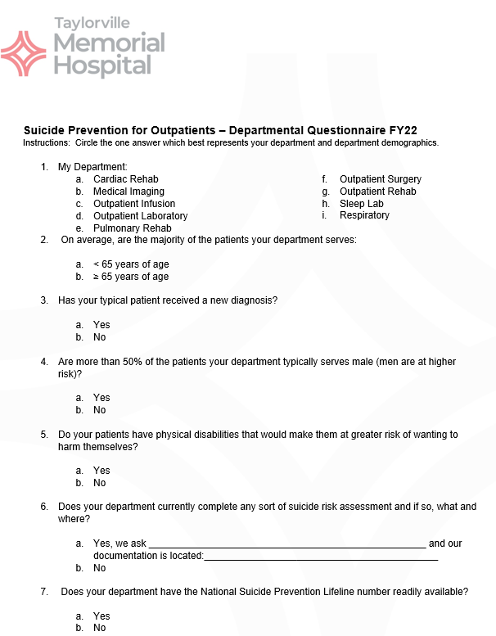
Measure
Develop Suicide Prevention for Outpatients – Departmental Questionnaire
  Assistance/guidance provided by Memorial Health partner, Director of Psychiatric Services, Springfield Memorial Hospital
Sent to the leader of each outpatient department (February 1st)
  Response requested by February 15th (two weeks)
Notes:
We then began to work on determining which outpatients are at the highest risk.
With the assistance of our Memorial Health partner, the director of psychiatric services at Springfield Memorial Hospital, a Departmental Questionnaire was developed to determine if the average patient treated in each outpatient care area is a suicide risk.
Each department was asked to complete the questionnaire and return within two weeks.

Slide 8
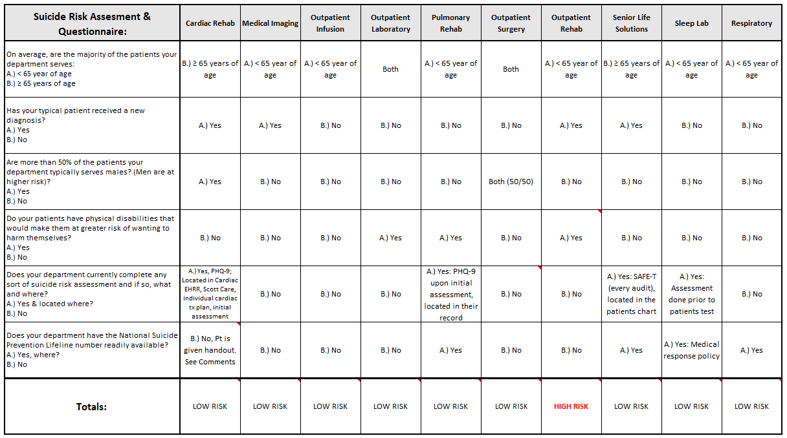
Analyze
Responses aggregated and analyzed to determine whether any outpatient care areas will be required to complete a Suicide Risk Assessment
  Assistance/guidance provided by Memorial Health partner, Director of Psychiatric Services, Springfield Memorial Hospital
  If > 2 risks on the questionnaire identified as correlating with risk of suicide were selected by the department leader, the department will be required to complete a Suicide Risk Assessment on all patients they serve ages 12 and older.
Notes:
The responses were then aggregated and analyzed.
If more than two answers on the questionnaire identified as correlating with a risk of suicide were selected, that department will now be required to complete a Suicide Risk Assessment on all patients they serve ages 12 and older.

Slide 9
Improve
Policy development – improve compliance with TJC
Documentation update
Education
Ultamately
Notes:
Once we analyzed the results, we moved into our improve phase, where we began to develop a policy, update documents in our EHR, and educate our teams.

Slide 10
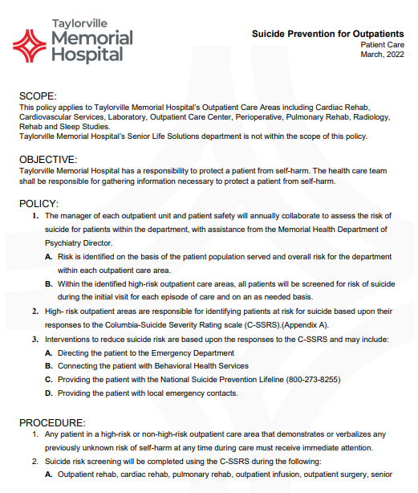
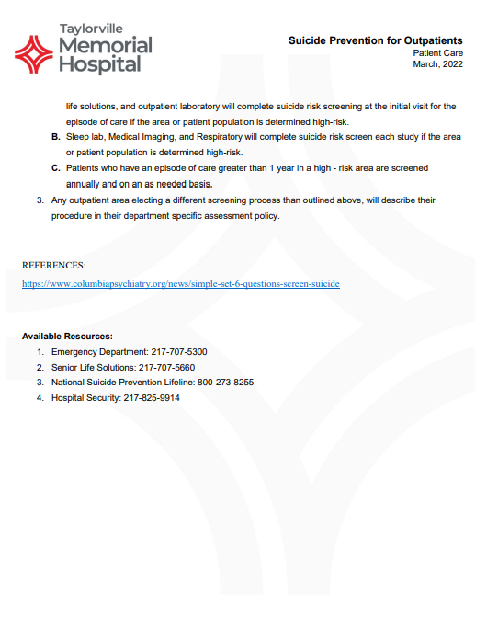
Improve – Policy Development
Notes:
The policy is screenshotted here and includes our scope, objective, and policies and procedures.

Slide 11
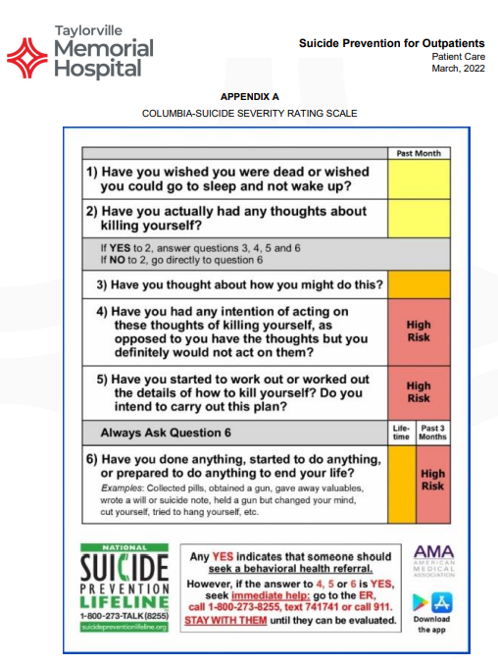
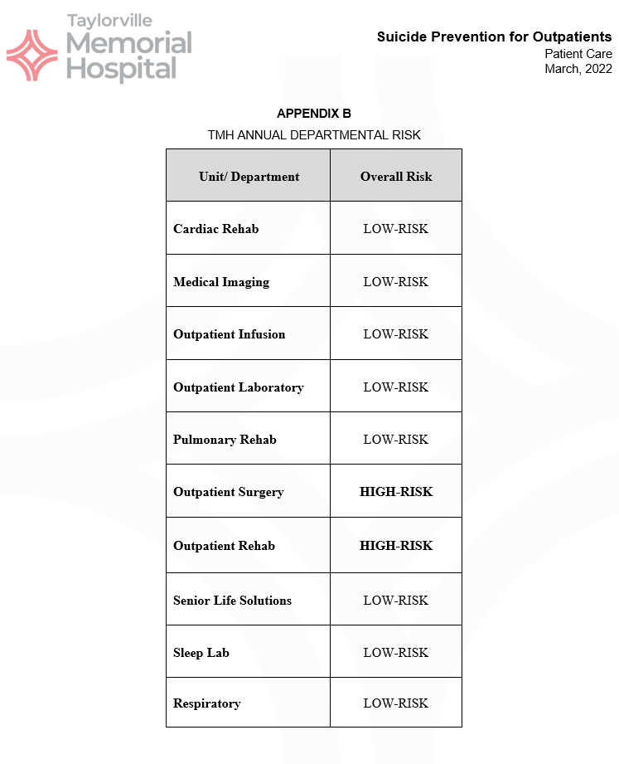
Improve – Policy Development
Notes:
Additionally, in the policy, we provided the Columbia Suicide Severity Rating Scale, which is used to determine risk status and the TMH department risk assessment assignment.

Slide 12
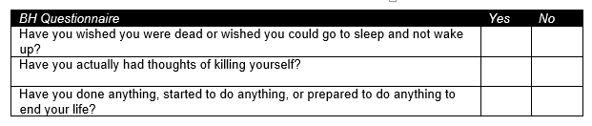
Improve – Documentation Update
Questions added to Rehab’s one page Patient Intake Form:
Notes:
Our outpatient therapy department has patient complete a quick, less than one page, intake form upon initial evaluation. These three questions are part of that intake form.

Slide 13
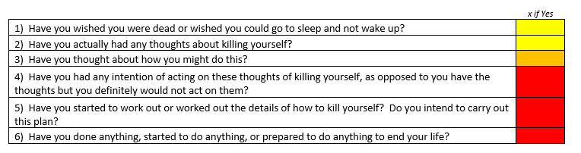
Improve – Education
Rehab colleagues, specifically Physical Therapists, Occupational Therapists, and Speech Language Pathologists, were trained to review the answers to the added questions on the Patient Intake Form.
If the patient marks “Yes” to any of the questions on the intake form, the above Rehab colleagues will follow-up with the remaining portion of the C-SSRC:
  Have you thought about how you might do this?
  Have you had any intention of acting on these thoughts of killing yourself, as opposed to you have the thoughts but you definitely would not act on them?
  Have you started to work out or worked out the details of how to kill yourself? Do you intend to carry out this plan?
Notes:
Next, the therapist evaluating the patient will review the responses on the intake form and, if indicated, continue on to the next portion of the Columbia Suicide Severity Rating Scale.

Slide 14
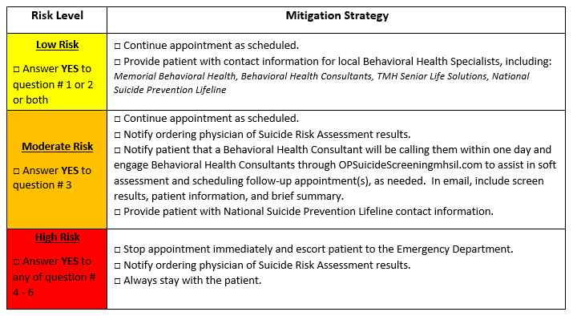
Improve – Education and Follow-Up
Notes:
When a patient is determined to be at risk of suicide, the therapy colleagues use this mitigation strategy matrix to provide support and follow-up with the proper, licensed personnel.

Slide 15
Improve – Education and Follow-Up
High level education provided to all other Outpatient Care areas
  C-SSRC
  Policy – be able to speak to the policy
  Resource Familiarity
Notes:
We then provided high level education to all outpatient colleagues, to be sure colleagues are familiar with the Columbia Suicide Severity Rating Scale, can speak to our policy, and know our local and national resources.

Slide 16
Control
Pulse Checks – frequent conversations with Rehab colleagues – ensure comfort with process
Chart Audits – department manager, department lead, Director of Clinical Operations, and Outpatient Care Center nurse manager perform routine audits – ensure policy adherence
Annual Update – questionnaire to be sent out to outpatient department leaders and policy updated annually (end of fiscal year) – ensure correct scope
Vizient Mock Survey – May 4th & 5th – seek consultative feedback on adherence to TJC standards
Notes:
In our control phase, we will continue frequent pulse checks with our therapy colleagues to ensure comfort with this new process, we will complete chart audits to ensure adherence.
This departmental questionnaire will be completed annually in all outpatient departments.
We will be seeking consultative feedback upon our May 4th & 5th Vizient Mock Survey.

Slide 17
Project and Self Evaluation
Lessons Learned:
Safety & Prioritization
Teamwork & Collaboration
Colleague Comfort
Notes:
I loved how the team came together to work on this project. It wasn’t a hassle, I received immediate buy-in and I attribute that to our values and the teams’ understanding of the importance of this project.
The team worked so well together. I enjoyed seeing leaders from all the areas at the table to discuss this significant topic. Additionally, all of the ad hoc and consultative team members were incredibly supportive and thrilled to provide input at SMEs.
I learned a lot about the comfort levels of different departments. Suicide Risk Assessments are nothing new to most of our nursing partners, though I saw how out of the norm this was for radiology, rehab, and lab and really grew to appreciate their efforts to learn and grow and meet the objectives in order to provide safe patient care.

