Slide 1
Taylorville Memorial Hospital Emergency Department Supply Room Renovation
Darin Buttz, Director of Community Health

Slide 2
Thank you!
Kim Bourne, President & CEO, Taylorville Memorial Hospital
Gregg Olsen, CEO, Rochelle Community Hospital
TMH Project Team

Slide 3
Core Statement
My organization, Taylorville Memorial Hospital, is developing a new medical supply storage system and location to help the Emergency Department improve efficiency and increase colleague satisfaction.

Slide 4

TMH Project Team
Casie Milner, ED Nurse Manager
Matt Thomas, Director, Plant Operations
Amanda Polley, Supply Chain Inventory Analyst
Natalie Scott, Emergency Medical Technician
Rebecca McCauley, Staff Nurse
*Established “STAKES IN THE GROUND” meetings every 2 weeks from 9-10am in the TMH Board Room

Slide 5
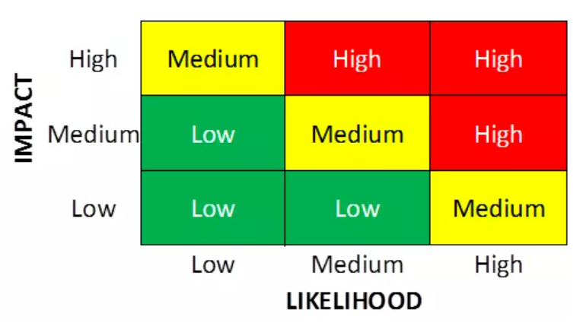
Risk/Impact Matrix
Top identified risks:
Lack of ED supply storage during project could potentially impact patient care
Increased work load on Central Supply during/post project
ED staff maintenance of supplies
    Colleague “buy-in” to new system
    Consistent ED colleague to do the ordering
    Goal of ordering once per week
Availability of contractor/materials to complete project

Slide 6
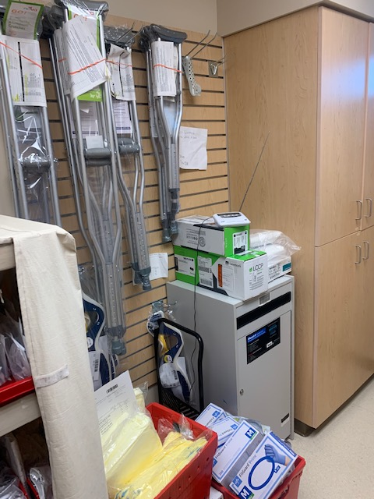
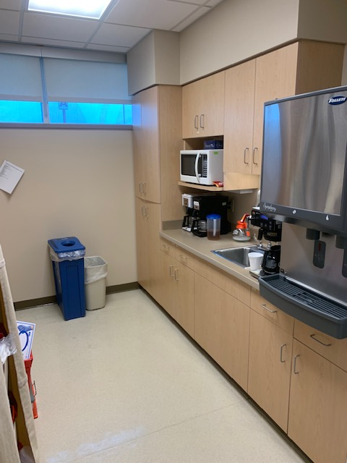
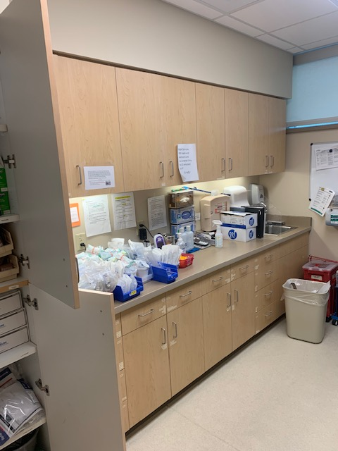
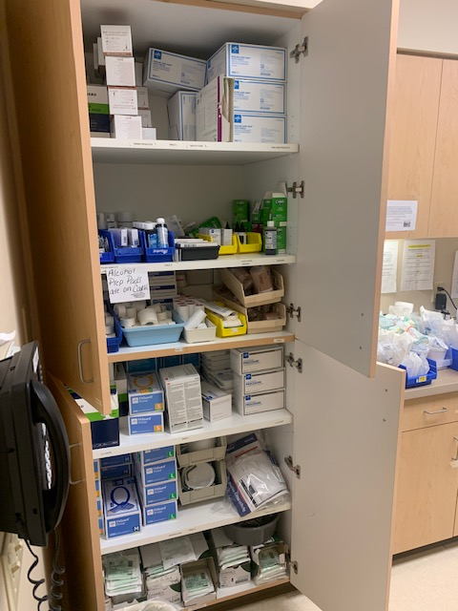
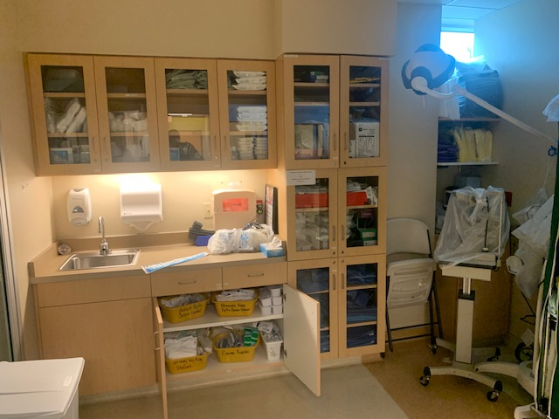
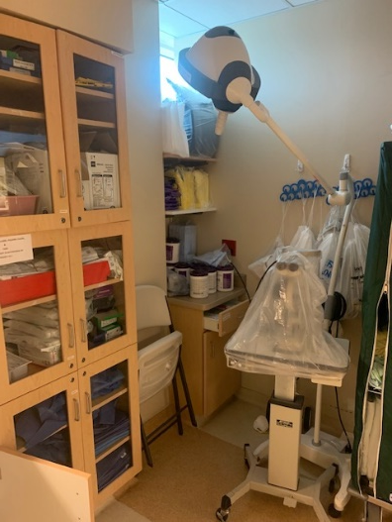
Current ED storage spaces

Slide 7
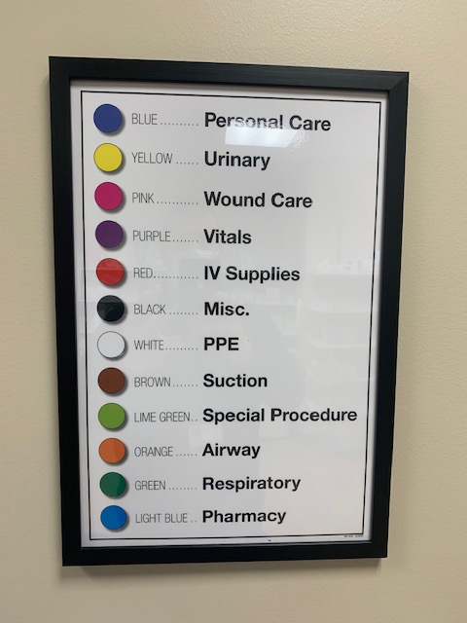
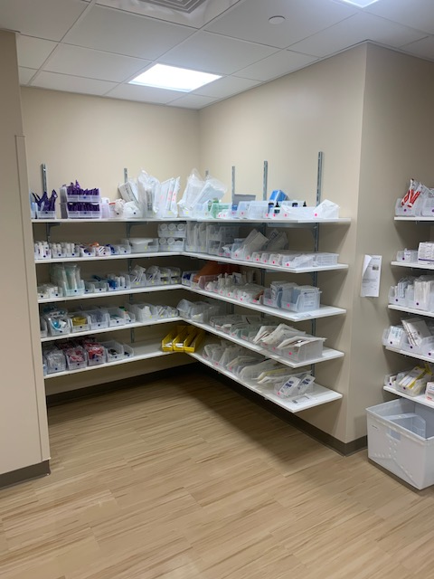
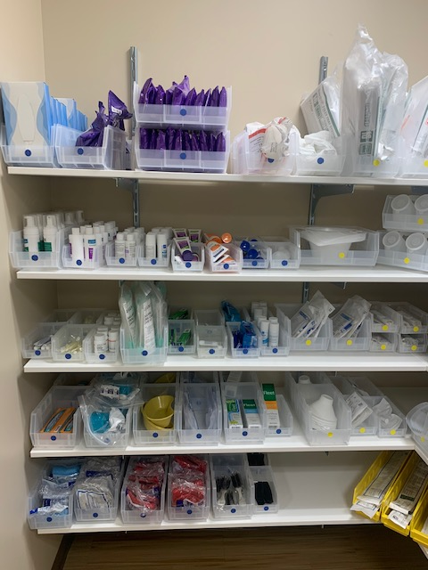
Current storage on Acute Care:
2 bin system
Color coded
Checked M/W/F by Central Supply
Visual on when supply low
Update Par levels and always have 3 days of supply on hand
Once bin is empty, it is removed from the shelf and second bin is slid forward

Slide 8
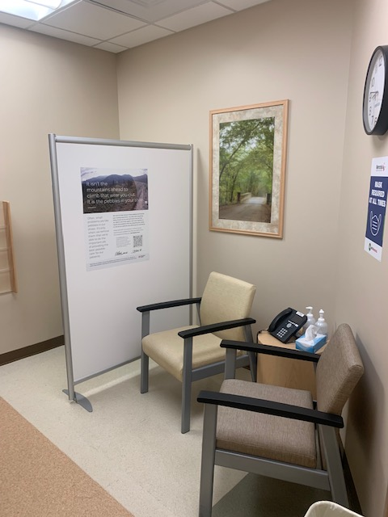
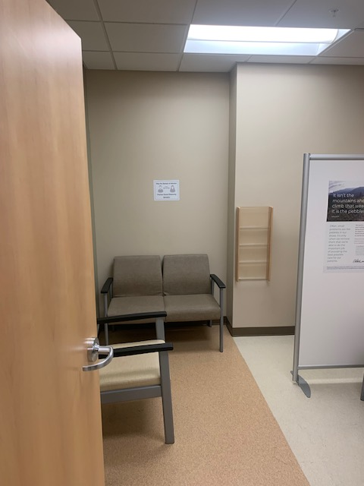
New ED Supply Room Area:
Consult Room

Slide 9

Barrier #1:
ED Provider Group Approval
Meeting on 2/16/22
Medical Director TMH ED Provider Group
TMH CEO
TMH CNO
ED Nurse Manager
Plant Operations Director

Slide 10
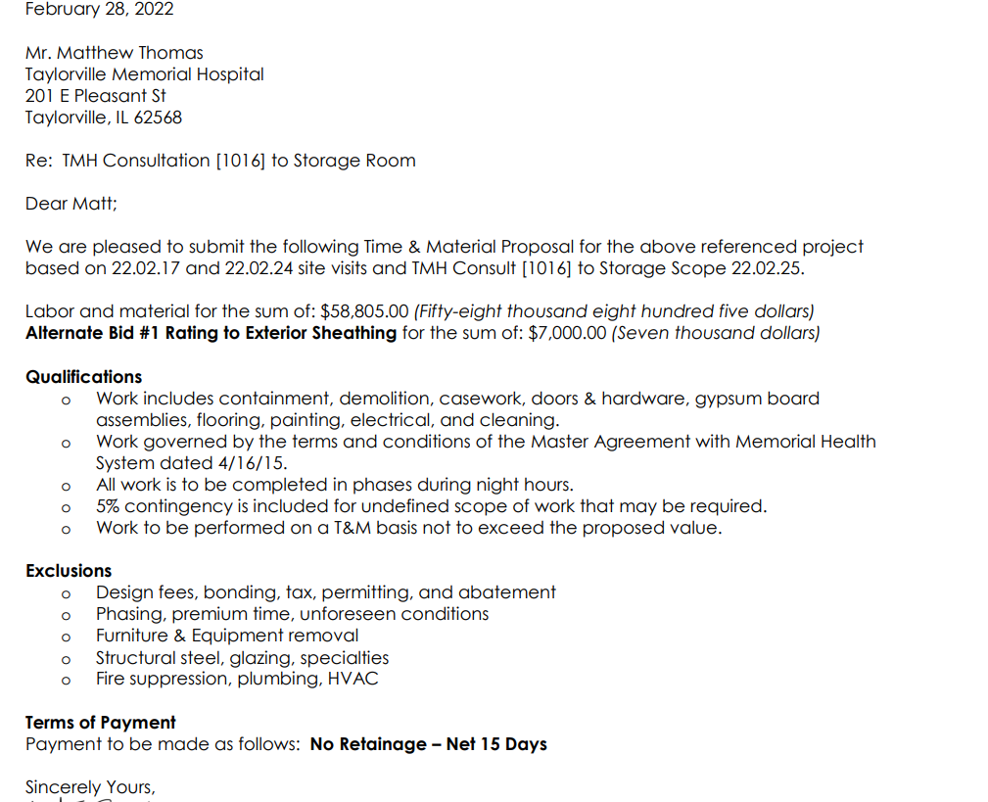
Barrier #2:
Bid on renovations: $58,805

Slide 11


Outcome to date
Decision was made to complete work “in house” at a drastically reduced cost
Anticipated project start date: May 2022
Projected project finish date: June 2022

Slide 12

Conclusion
This project was attempted 2 other times over the past few years and failed due to various issues. We now have a projected completion date.
Future considerations would include having ED provider representative on Project Team.
Risk that almost derailed entire project: HIGH CONSTRUCTION BID.

