Slide 1
Providing Inter-hospital Transport for Patients at Hopedale Medical Complex
Aldo M. Rossi

Slide 2

Overview and Purpose
HMC is experiencing continued delays in private ambulance transport for interhospital transfers
Delays in transport have historically reached 2 hours for urgent transfers
Continued struggles with staffing in organizations will lead to continued and possibly longer wait times
Objective is to provide an alternative and internal transfer plan that can be utilized for our patients rather than relying on the private transport

Slide 3
Objectives and Deliverables and Timeline
Objectives:
Establish an internal EMS transfer system for HMC patients who need interhospital transfers
Reduce the average time between transfer order and departure of patient from the hospital/ER
Reduce average ER visit lengths for patients who need transferred
Deliverables
Decrease in transfer delays
Improved outcomes for patients
Timeline – Goal of implementation by January 2023

Slide 4

Stakeholders and Buy-in
Board of Directors
Medical Director
CEO/COO
CNO
Hopedale Rescue Squad
Staff
Meetings held with Medical Director, CNO, CEO, COO, and Hopedale Rescue Chief – in agreement for need of project

Slide 5
Activities
Meeting with Stakeholders
Establish EMS license presence/interest in organization
Establish Finances/Budget/Billing
Acquire Ambulance
Apply for proper licensing
Establish billing structure
Establish staffing structure

Slide 6
Successes and Barriers
Successes
  Completion of EMS course
  Buy in from stakeholders
  Attaining vehicle
  Support from staff with EMS licenses
Barriers
  Times constraints
  Staffing shortage
  Ambulance preparations – can't complete until structure established and licensing approved

Slide 7
Outcomes to Date
Project Charter completed
Approval from COO to continue project
Staff support for project – total of 8 licensed EMS team members on staff
Pay structure established – will consist of bonus pay per ride given plus 1.5x hourly wage
Emergency Medical Services (EMS) Systems Act reviewed for sufficient staffing model

Slide 8
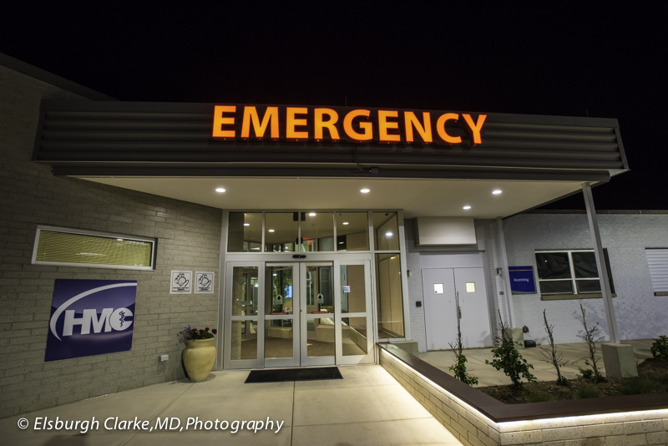
Conclusions/Next Steps
Present staffing model and policies/procedures for COO/Medical director to review
Determine and draft budget for project (staffing, supplies)
Determine projected revenue from services
Apply for EMS transport license
Service/stock ambulance with equipment and supplies

